Slide 1
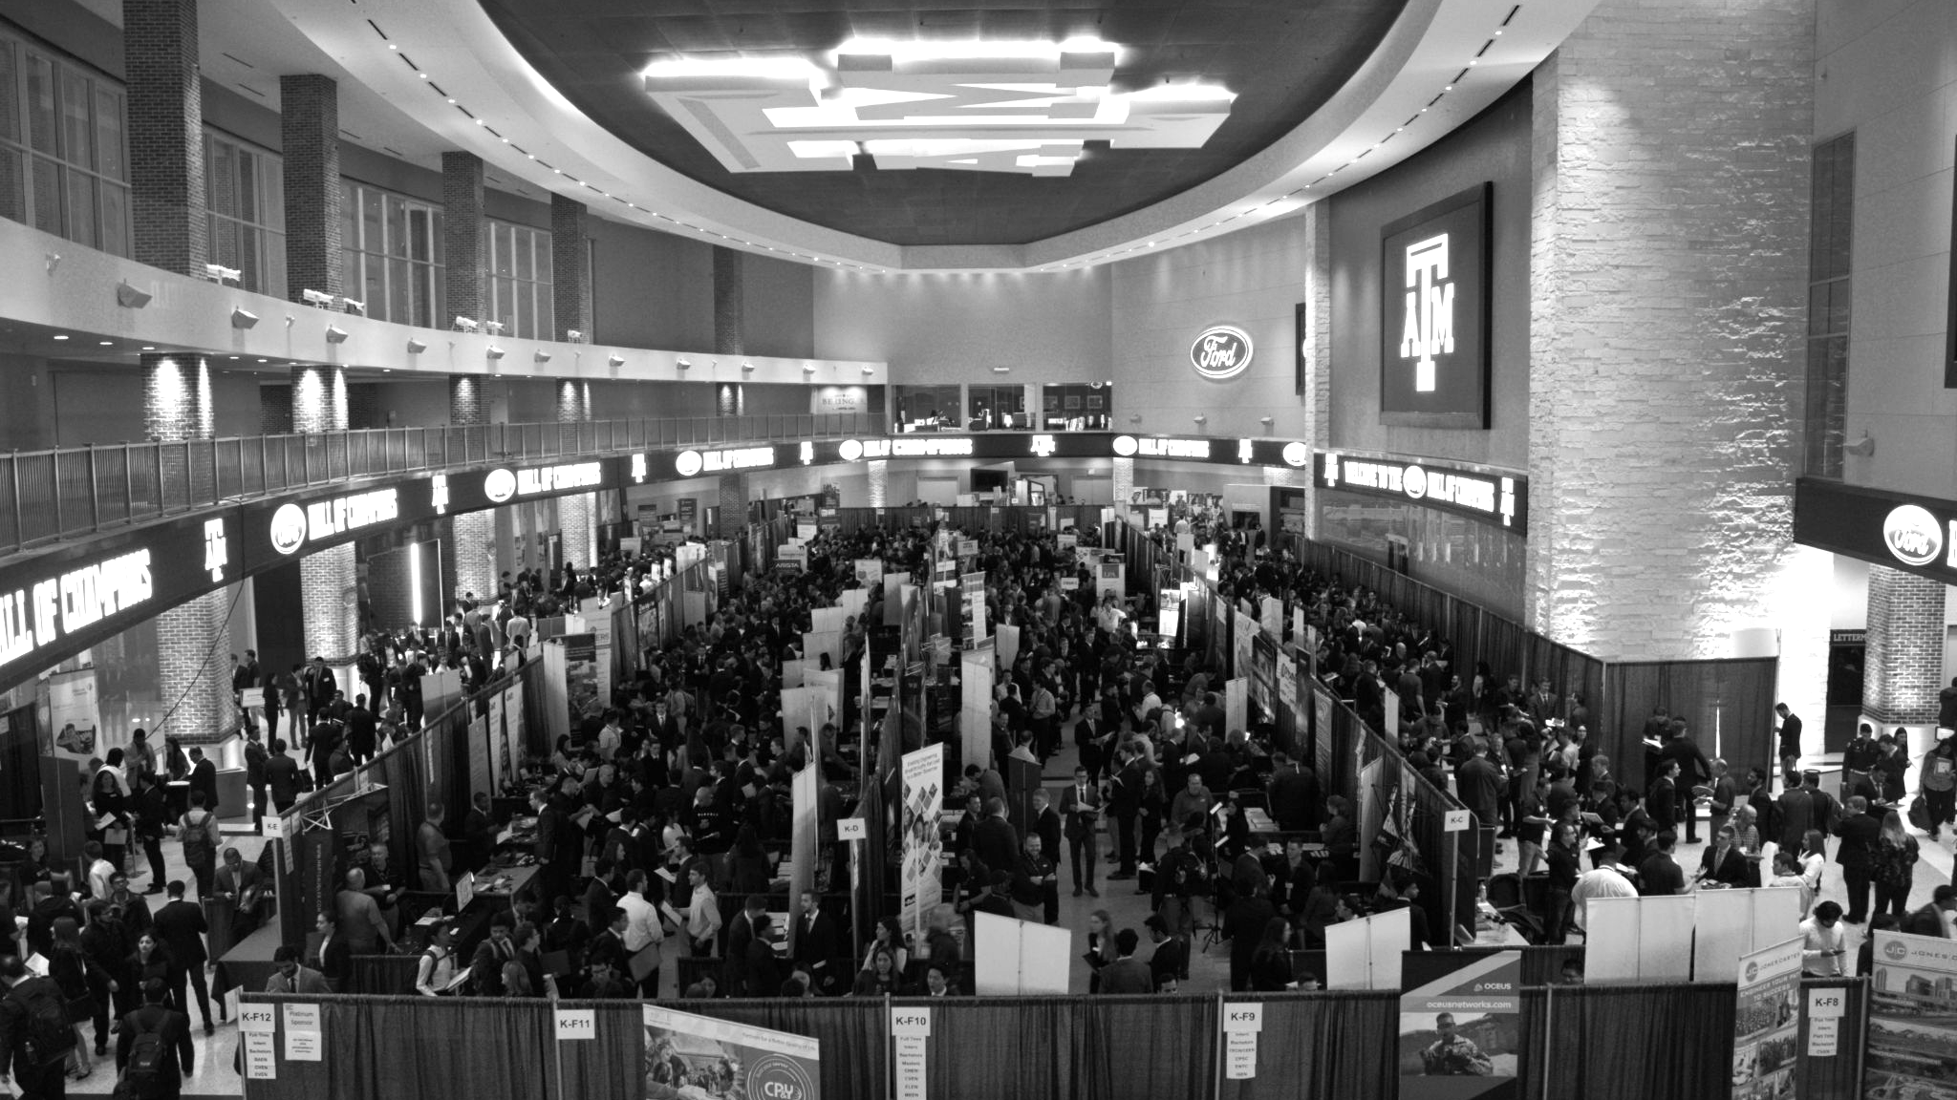

Final Presentation: Human Robotic Arm Attachment
Los Alamos National Laboratory
Team: Dalton Boeckmann, Izzy Baumler, Jade Waldron, Morgan Gullo

Slide 2
Agenda
Introduction
Problem
Customer Needs
Design Requirements and HOQ
Functional Modeling
Concept Generation
Concept Refinement
Concept Selection
Embodiment Design
Validation Plan
MEEN 401 Scheduling and Managing a Project
Final Deliverables
Future Work
Notes:
Our project is focused on developing a robotic arm solution to manage the radioactive waste stored at the Hanford Site in Washington State. This site has accumulated over 56 million gallons of waste stored in tanks that have far exceeded their intended lifespans. With the tanks now deteriorating, this poses serious environmental risks to local communities and ecosystems.
Problem Statement: "Our challenge at the Hanford Site revolves around removing radioactive waste in extremely confined spaces and under high-radiation conditions. The tanks holding this waste were designed to last only 25 years, yet many have far exceeded that lifespan, making the risk of leakage a pressing concern. Current solutions lack the needed durability, access capability, and flexibility for handling the solidified waste."
Project Objectives: "Our team’s primary objectives are to create a robotic arm capable of high mobility, durability, and efficiency for use in these restricted environments. We’re partnering with Los Alamos National Laboratory to bring this solution to life, and we're targeting a design that addresses all these challenges without risking human exposure to radiation."
Solution Approach: "Our proposed solution is a six-degree-of-freedom robotic arm mounted on a quadruped robot. This setup provides the stability needed for operations on uneven surfaces within the tanks. The 6-DoF arm, with its human-like mobility, will maneuver effectively within confined spaces to tackle both the liquid and solidified waste, ensuring efficient and comprehensive cleaning operations."
Key Challenges: "There are several critical obstacles our team is addressing: limited access due to one-foot-diameter tank openings, high radiation levels that damage equipment, and the need for rapid, remote operation. Many existing robotic systems can either manipulate or move quickly but struggle to do both effectively in a confined space. This project aims to fill that gap by providing both mobility and precise control within these extreme conditions."

Slide 3
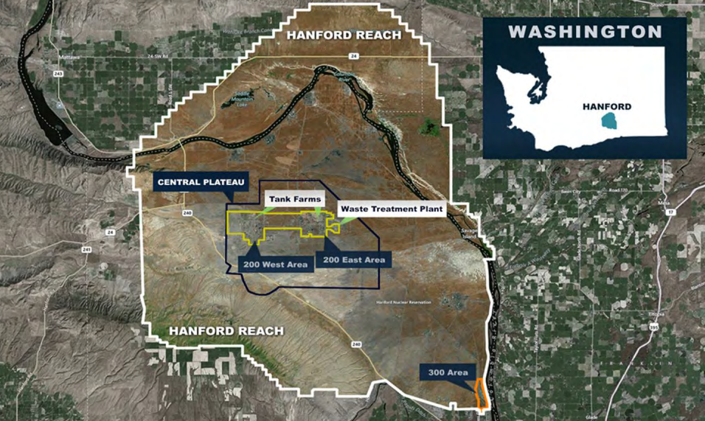
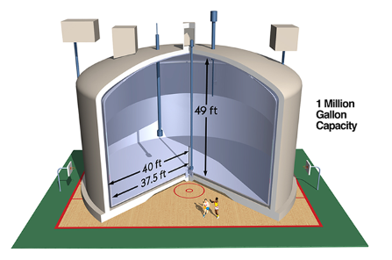
Problem Identification
Location: Hanford Site, Washington State
Background: 45+ years of plutonium production has led to 56 million gallons of hazardous and radioactive waste stored at the Hanford Site.
Problem: Original tanks designed for 25 years; most now exceed this, with approximately 68 tanks in critical condition.
Risk: High environmental and health risks due to tank deterioration, posing a growing threat to surrounding areas.
Notes:
Our problem takes place…. Over its 45 years of plutonium production, the Hanford Site in Washington State has accumulated over 56 million gallons of mixed hazardous and radioactive waste. The waste was initially stored in tanks designed to last 25 years; however, most of these tanks have far exceeded their intended lifespans, with about 68 tanks reaching critical conditions. The state of these tanks poses an increasing threat to both local populations and infrastructure. Through the partnership with Los Alamos National Laboratory (LANL) and Texas A&M, our senior design team has been tasked to design and fabricate a solution for this problem.

Slide 4
Problem
I. Solution Neutral Problem Statement
II. Mission Statement

Slide 5
Solution Neutral Problem Statement
The Solution Neutral Problem Statement (SNPS) serves as the foundation for defining the project’s functionality and requirements.
By focusing on high-level project needs rather than specific solutions, the SNPS was derived.
The scope of the project and evolving custom requirements prompted regular revisions to the SNPS, ensuring ongoing alignment with project goals.
SNPS | There is a need for a technology that has 6 DOF and can move through its full range of motion in each degree of freedom of at least 1 Hz.
Customers | Department of Energy, National Research Laboratories
Notes:
In order to keep the project streamlined, the team identifies a snps to serve as the foundation of the projects functionality and requirement
This was used by focusing on high level project needs rather than specific solution, in order to allow for maximum possible solutions
Due to neutreality of this statement, it made it easy for iterative revisions, to ensure ongoing alignment with project hgoals
Finally, tyo date our snps, is as stated …, There is a need for a technology that has 6 DOF and can move through its full range of motion in each degree of freedom around 1 Hz.

Slide 6
Mission Statement
Mission statement to clarify the LANL project team’s design goals, aligning with both design team and customer needs.
The mission statement specifies that the LANL project team will design and prototype a 6 DoF robotic arm.
Areas of optimization:
Material selection
Robotic Actuation
A semi-autonomous control system
Mission Statement: Human Robotic Arm
Product Description | Design a 6 DoF robotic arm with human like functionality
Key Business or Humanitarian Goals | Effectively clean nuclear waste from Nuclear Waste Tanks to prevent contamination of local environments and populations Successfully Prototyped and Fabricate Robotic arm within 8 months
Primary Market | Department of Energy
Secondary Market | US Government, US Military, Nuclear Energy
Assumptions | We can assume: that the robot can withstand harsh radioactive environments, the robot can handle large amounts of force without tipping over, the robot can handle large amounts of force without damaging the tank wall, and visibility will allow for sensors to determine if plutonium is being removed, we assume the material is a hard tar heel substance
Stakeholders | Washington Citizens, National Research Labs, Department of Energy
Avenues for Creative Design | Material, robotic actuation for arm movement and control, Semi-Autonomous
Scope Limitations | Resources, only 4 group members, only 8 months to work on it, Size limits, Force limits to protect the tank, Material selection, Dynamic capabilities
Notes:
Material selection for durability and performance, robotic actuation for speed and efficiency, and semi autonomous control system improved usability
Given limited resources and timelines, the team chose to prioritize the mechanical aspects of the design, specifically focusing on optimizing the speed and dynamic capabilities of the manipulator.

Slide 7
Customer Needs
Supplemental Design Survey
Customer Interviews
Customer Needs
Needs Analysis

Slide 8
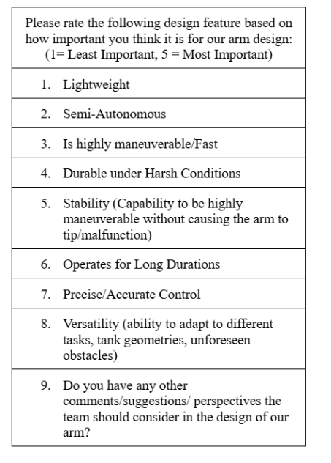
Supplemental Design Survey
13 Respondents of various backgrounds in industry

Slide 9
Customer Interviews
Question | Customer Statement (Rodrigo Ramon) | Customer Statement (Michael Tomlin) | Interpreted Need | Weight | Activity
What specific motions would you expect the robot /robotic arm to handle on a regular basis? (Movement, force) | The robot should be capable of moving back and forth over a specific area during cleaning operations. | The robot needs to perform sweeping motions and accurately identify the edges of curved surfaces on the wall, requiring mathematical precision to navigate these arcs effectively. | The robotic arm must be able to perform repetitive back-and-forth movements over designated areas while also executing sweeping motions to ensure thorough cleaning. | 3 | Executing precise movement patterns to clean specified areas and navigate curved wall surfaces effectively.

Slide 10
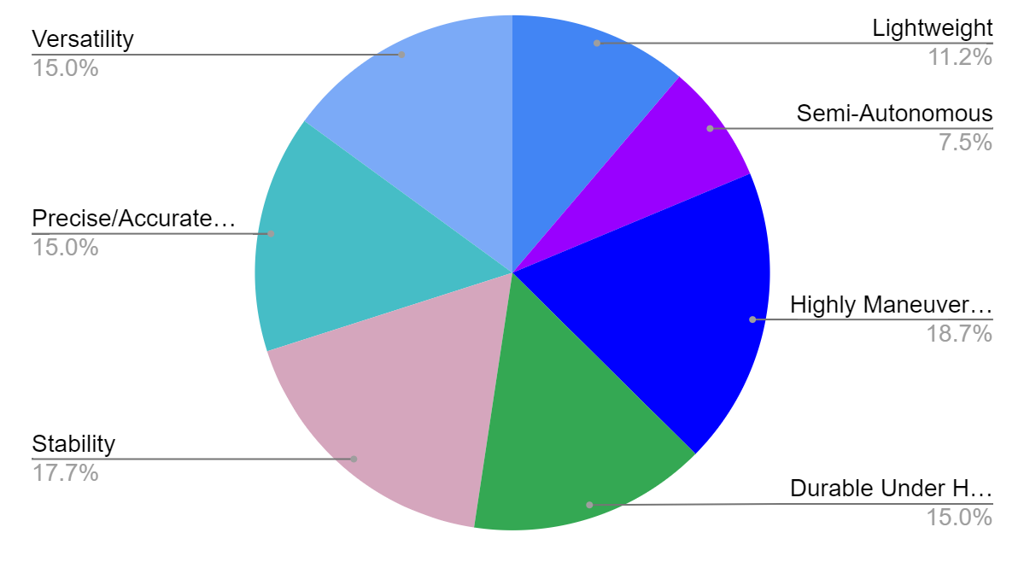
Customer Needs

Slide 11
Customer Needs
Employed various methods, including preliminary research, customer interviews, and supplemental design surveys to identify and rank critical needs
# | Designated Need | Importance Score (1 to 5, 5 = most important)
1 | Highly Maneuverable/Fast | 5
2 | Precise/Accurate Control | 4
3 | Versatile | 4
4 | Durable under harsh conditions | 4
5 | Stable | 4
6 | Lightweight | 3
7 | Semi-Autonomous | 2

Slide 12
Needs Analysis
Fast and Agile Operation: The 6 DOF robotic arm must move quickly and easily to clean complex spaces, like plutonium tanks, while avoiding obstacles.
Flexible and Versatile: It should perform sweeping and following motions to handle different cleaning tasks and reach tough spots.
Key Performance Needs: The arm should operate smoothly across 6 degrees of freedom at a speed of around 1 Hz, focusing on responses to changes in the environment.

Slide 13
Design Requirements and HOQ
House of Quality
Design Requirements

Slide 14
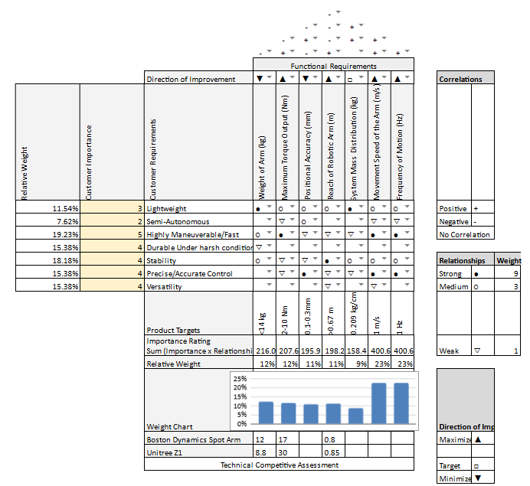
House of Quality
The HOQ relates customer needs to functional requirements, describes how the arm design compares to existing products, identifies functional conflicts, and calculates the relative weights of each functional requirement.
Notes:
A HOQ organizes design decisions by translating qualitative customer needs into quantitative requirements, identifying relationships and conflicts between metrics, and determining design priorities. The HOQ for the robotic arm is shown in Figure 2. The team discovered from the HOQ that designing

Slide 15
Design Requirements
The Design Requirements Table cross-references requirements with the customer needs satisfied. The table provides the importance of each metric as well as the target value.
Requirement # | Need # | Metric | Importance Score (1 to 5, 5 = most important) | Required Values | Units
1 | 7,5 | Weight of the Arm | 3 | <14 | kg
2 | 1,2,4 | Maximum Torque Output | 3 | 2-10 | Nm
3 | 2,3,8 | Positional Accuracy | 3 | 10-30 | mm
4 | 2,5 | Reach of Robotic Arm | 3 | >0.67 | m
5 | 3,5,7 | System Mass Distribution | 2 | 0.209 | kg/cm
6 | 1,2 | Max Movement Speed of the Arm | 5 | 1 | m/s
7 | 1,2,3,5 | Frequency of Motion | 5 | 1 | Hz
Notes:
which serves as an essential tool for cross-referencing requirements with specific customer needs, The design team encountered challenges in directly using the importance scores from the Customer Needs Table due to the complexity of the HOQ, which indicated that each customer need corresponds to multiple functional requirements and vice versa. Consequently, a new weighting system was developed by dividing each requirement’s Technical Importance Rating from the HOQ by the maximum Technical Importance Rating, multiplying by five, and rounding to ensure consistency with the Customer Needs Table. The resulting weights are generally aligned with the priorities outlined in the Customer Needs Table.

Slide 16
Functional Modeling
Black Box Model
Complete Functional Model

Slide 17
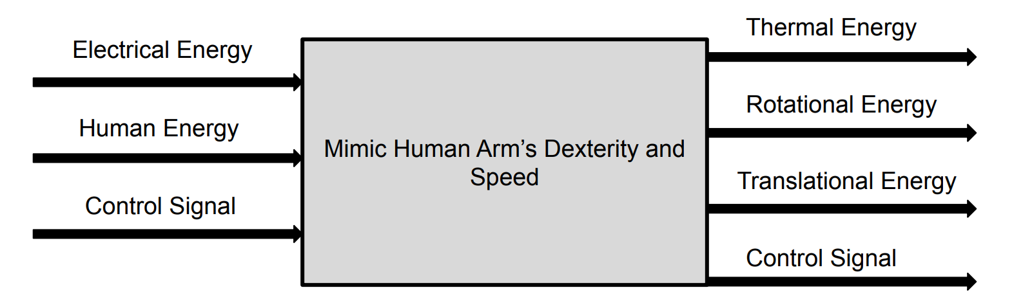
Functional Modeling
In order to understand what functions need to be completed by the design, the team developed a Functional Model
Outlines what the proposed robotic arm design aims to achieve using standardized solution-neutral language
Input and output flows were identified by analyzing the energy, materials, and signals required for the model to fulfill its function

Slide 18
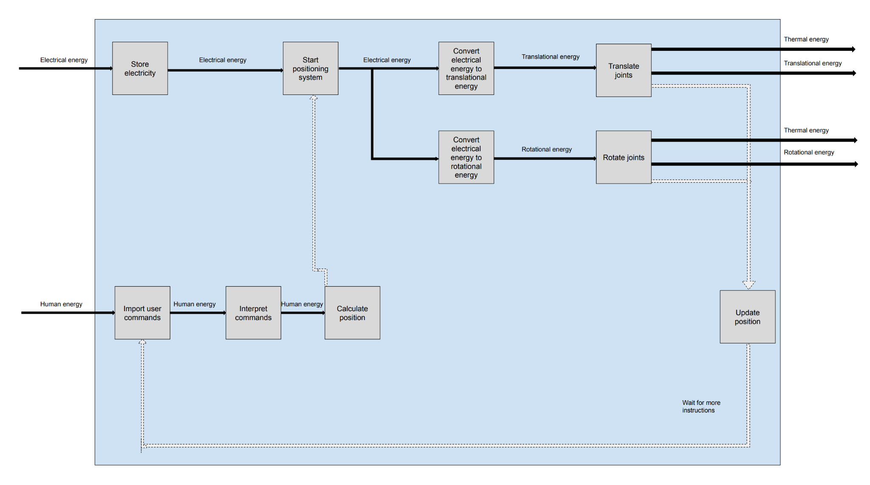
Functional Modeling
Each customer need was then linked to a corresponding functional flow
All subfunction chains were then merged into a single diagram
Notes:
Each customer need was then linked to a corresponding functional flow
All subfunction chains were then merged into a single diagram

Slide 19
Concept Generation
I. Brainstorming
II. Design by Analogy
III. TIPS/TRIZ
IIII. Morphological Analysis

Slide 20
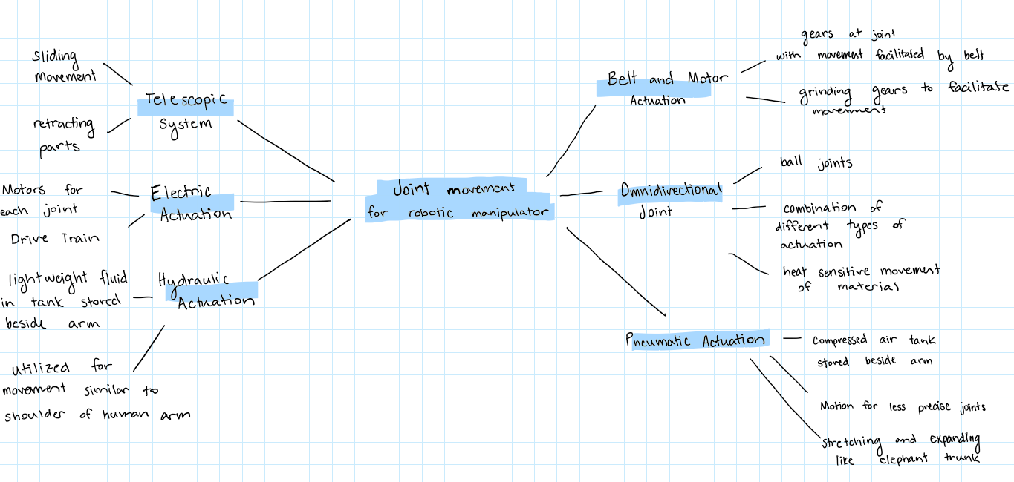
Brainstorming
Brainstorming is a creative problem-solving technique used to generate a large number of ideas in a short period of time
Encourages open, free-flowing thinking and emphasizes quantity over quality
The team focused on how the joints of the manipulator would move

Slide 21
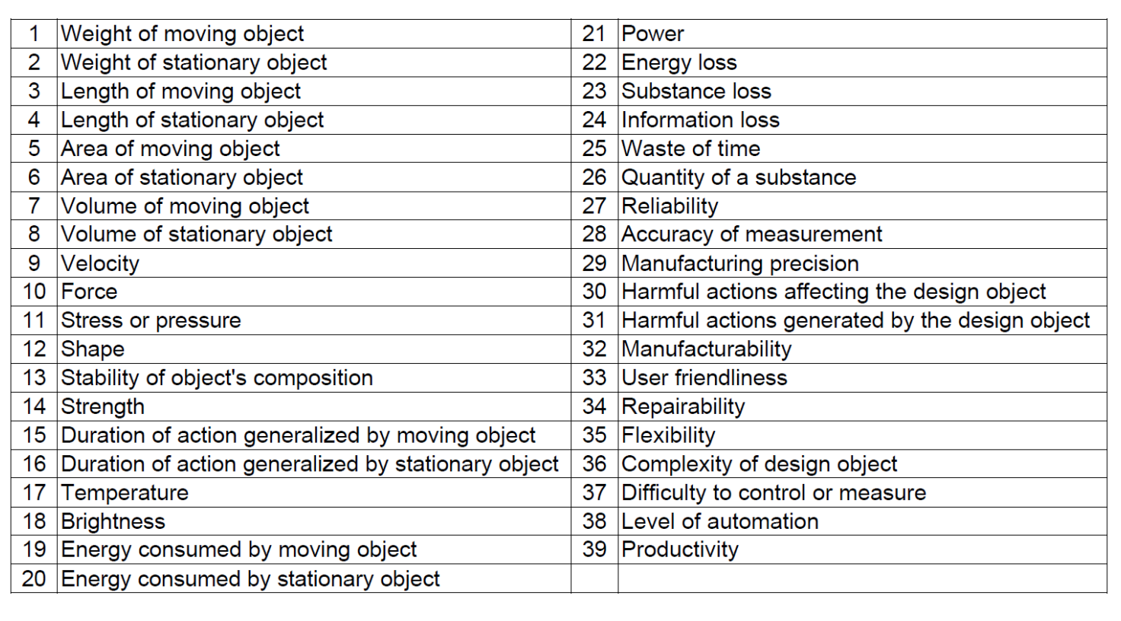
Theory of Inventive Problem Solving
Theory of Inventive Problem Solving (TRIZ) is a structured idea generation method developed by analyzing patents
By focusing on eliminating trade-offs and conflicts within a system, TRIZ fosters breakthrough thinking and drives innovation
The team identified 2 conflicts
Decreasing the weight of a moving object (Parameter 1) and increasing the velocity (Parameter 9)
Decreasing the complexity of the design object (Parameter 36) and increasing the velocity (Parameter 9)

Slide 22
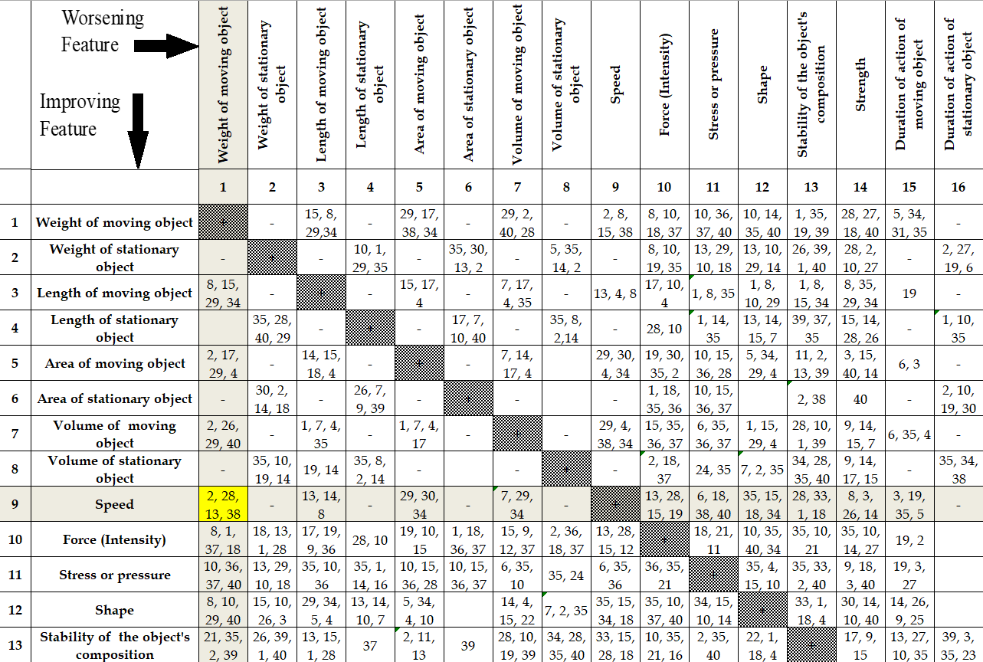
TRIZ Continued
Once the conflicts were defined in generalized engineering parameters, the TRIZ contradiction matrix was used to identify design principles that could be used to generate solutions

Slide 23
TRIZ Continued
Conflict | Principals
1) Decreasing the weight of a moving object (Parameter 1) and increasing the velocity (Parameter 9) | 2: Taking out
 | 28: Mechanics substitution
 | 13: ‘The other way round’
 | 38: Strong oxidants
2) Decreasing the complexity of the design object (Parameter 36) and increasing the velocity (Parameter 9) | 28: Mechanics substitution
 | 4: Asymmetry
 | 10: Preliminary action
Notes:
These are the principles that applied to the first and second conflict

Slide 24
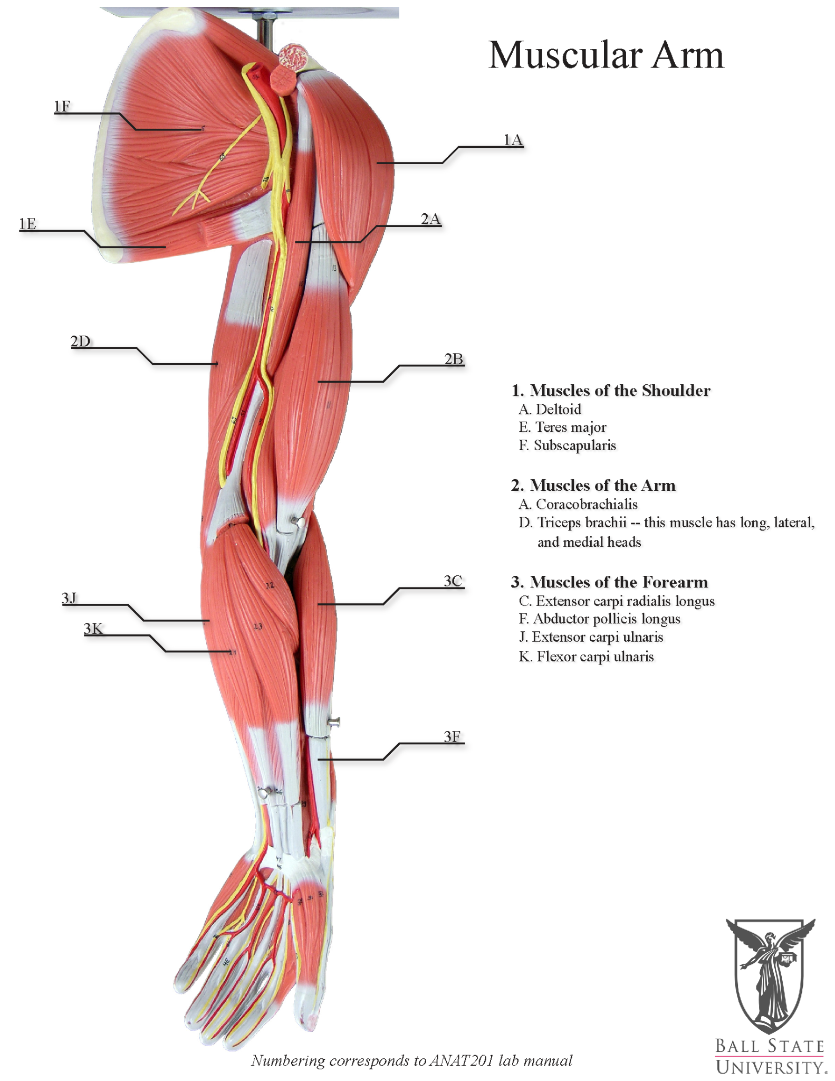
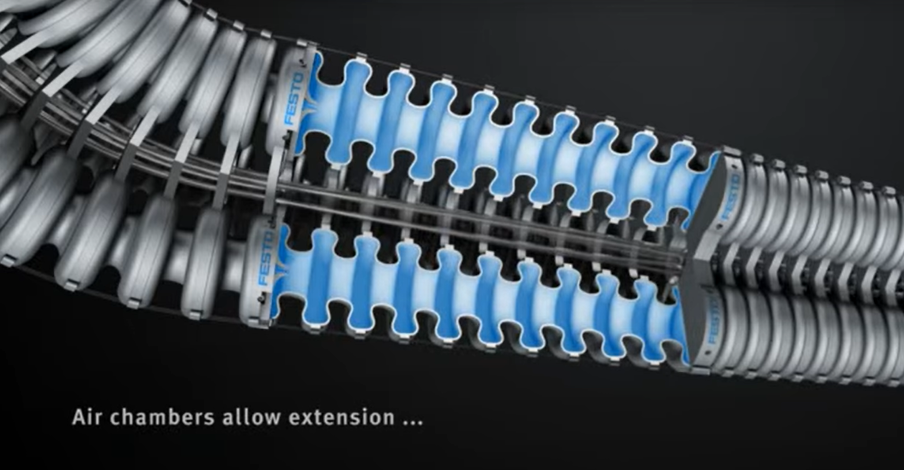
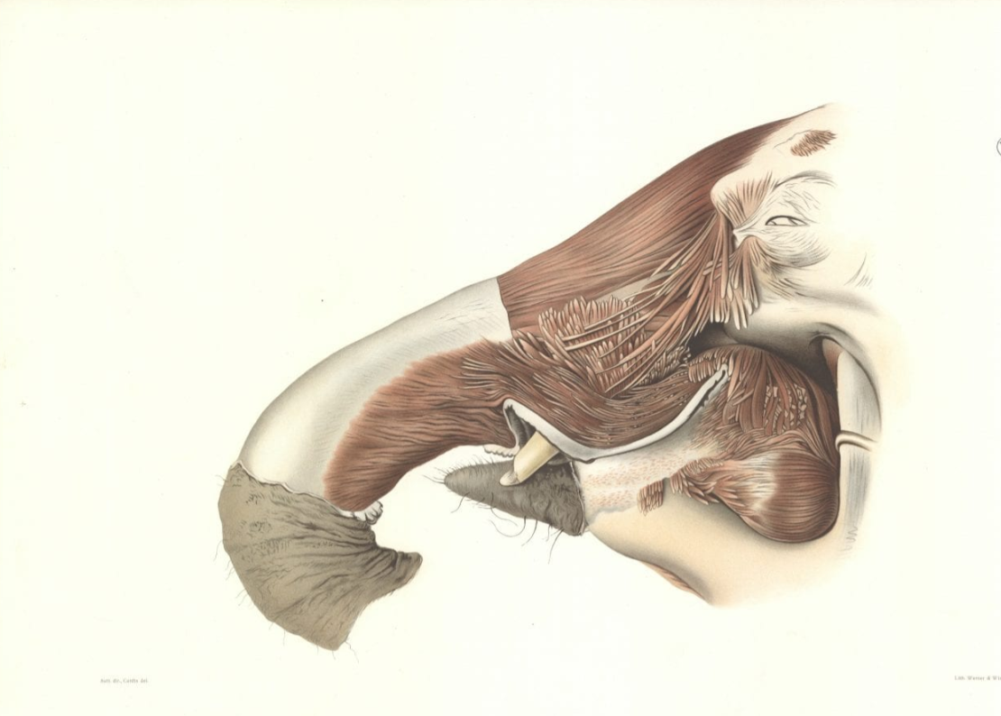
Design by Analogy
Design by analogy is an idea generation method that takes inspiration from natural systems to solve a design problem
By identifying similarities between the present challenge and analogous situations in unrelated domains, designers can leverage proven principles and approaches to generate innovative concepts
The team chose to research an elephant trunk and human arm

Slide 25
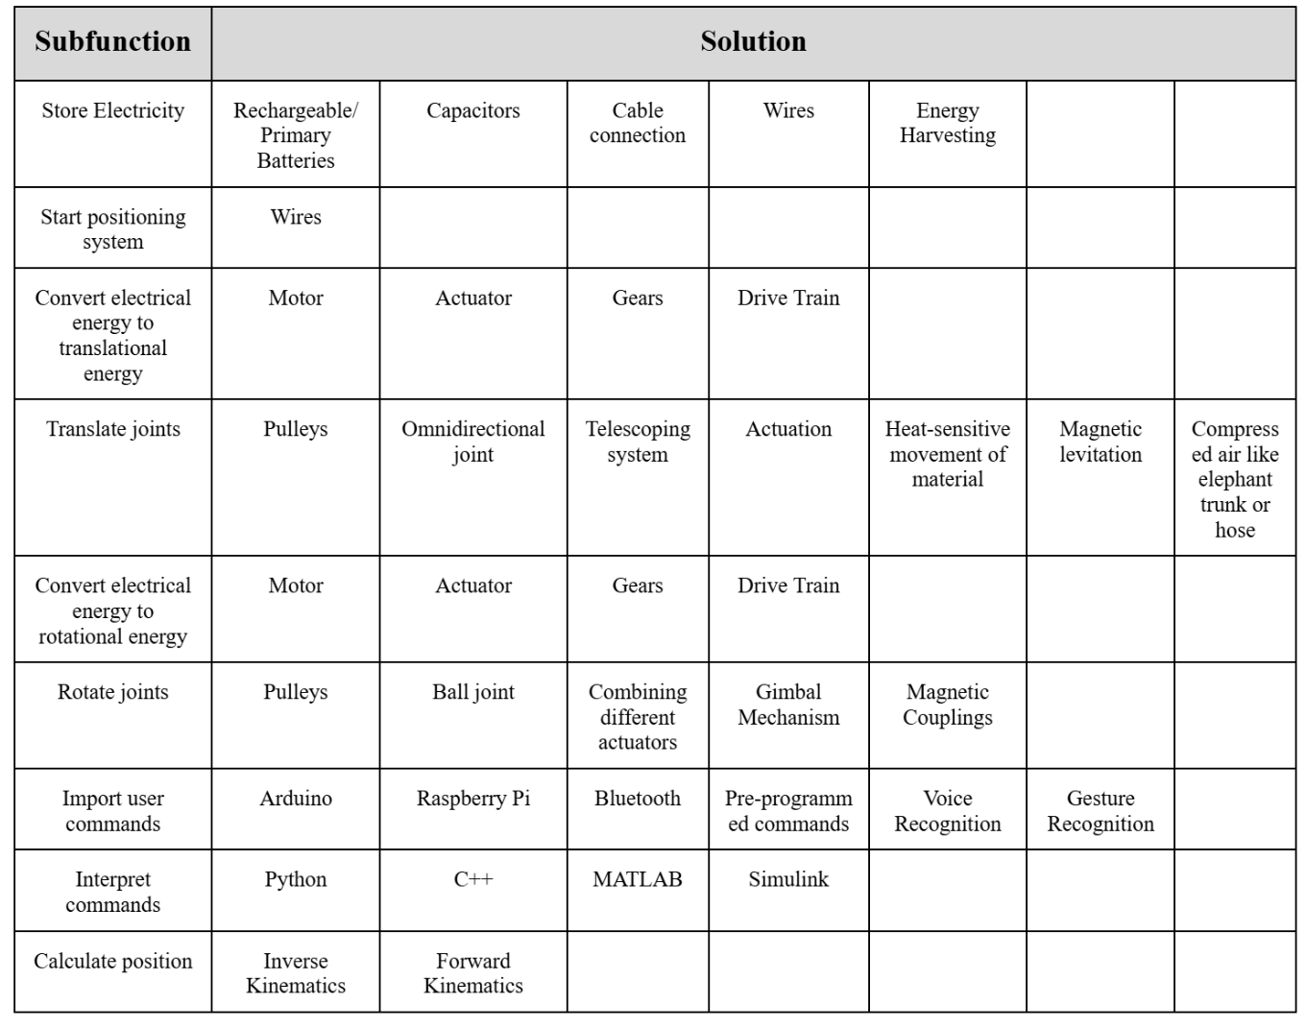
Morphological Analysis Matrix
The final phase of idea generation was morphological analysis which is a structured method used to explore all possible solutions by breaking it down into its fundamental components.
This technique encourages creative thinking by systematically examining the relationships between the different parameters of a problem
This process involves identifying key functions of the product and listing potential solutions

Slide 26
Concept Refinement
I. Concept Definition
II. Detailed Sketches

Slide 27
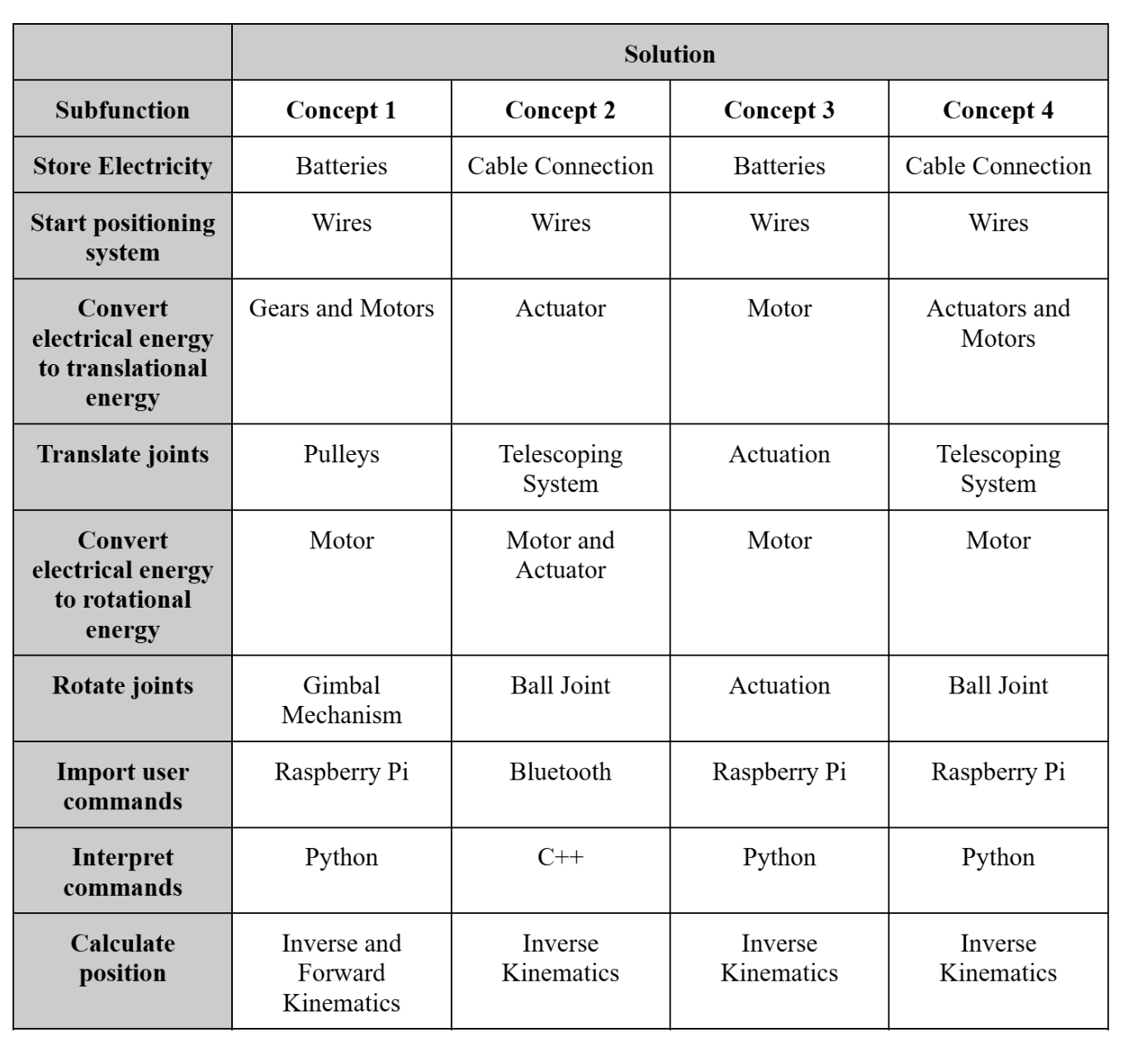
Concept Definition
Analyzing the range of possible solutions for each sub-function within the Morphological Matrix resulted in the development of several well-defined concepts for the robotic arm
Each team member created a concept based on this criteria

Slide 28
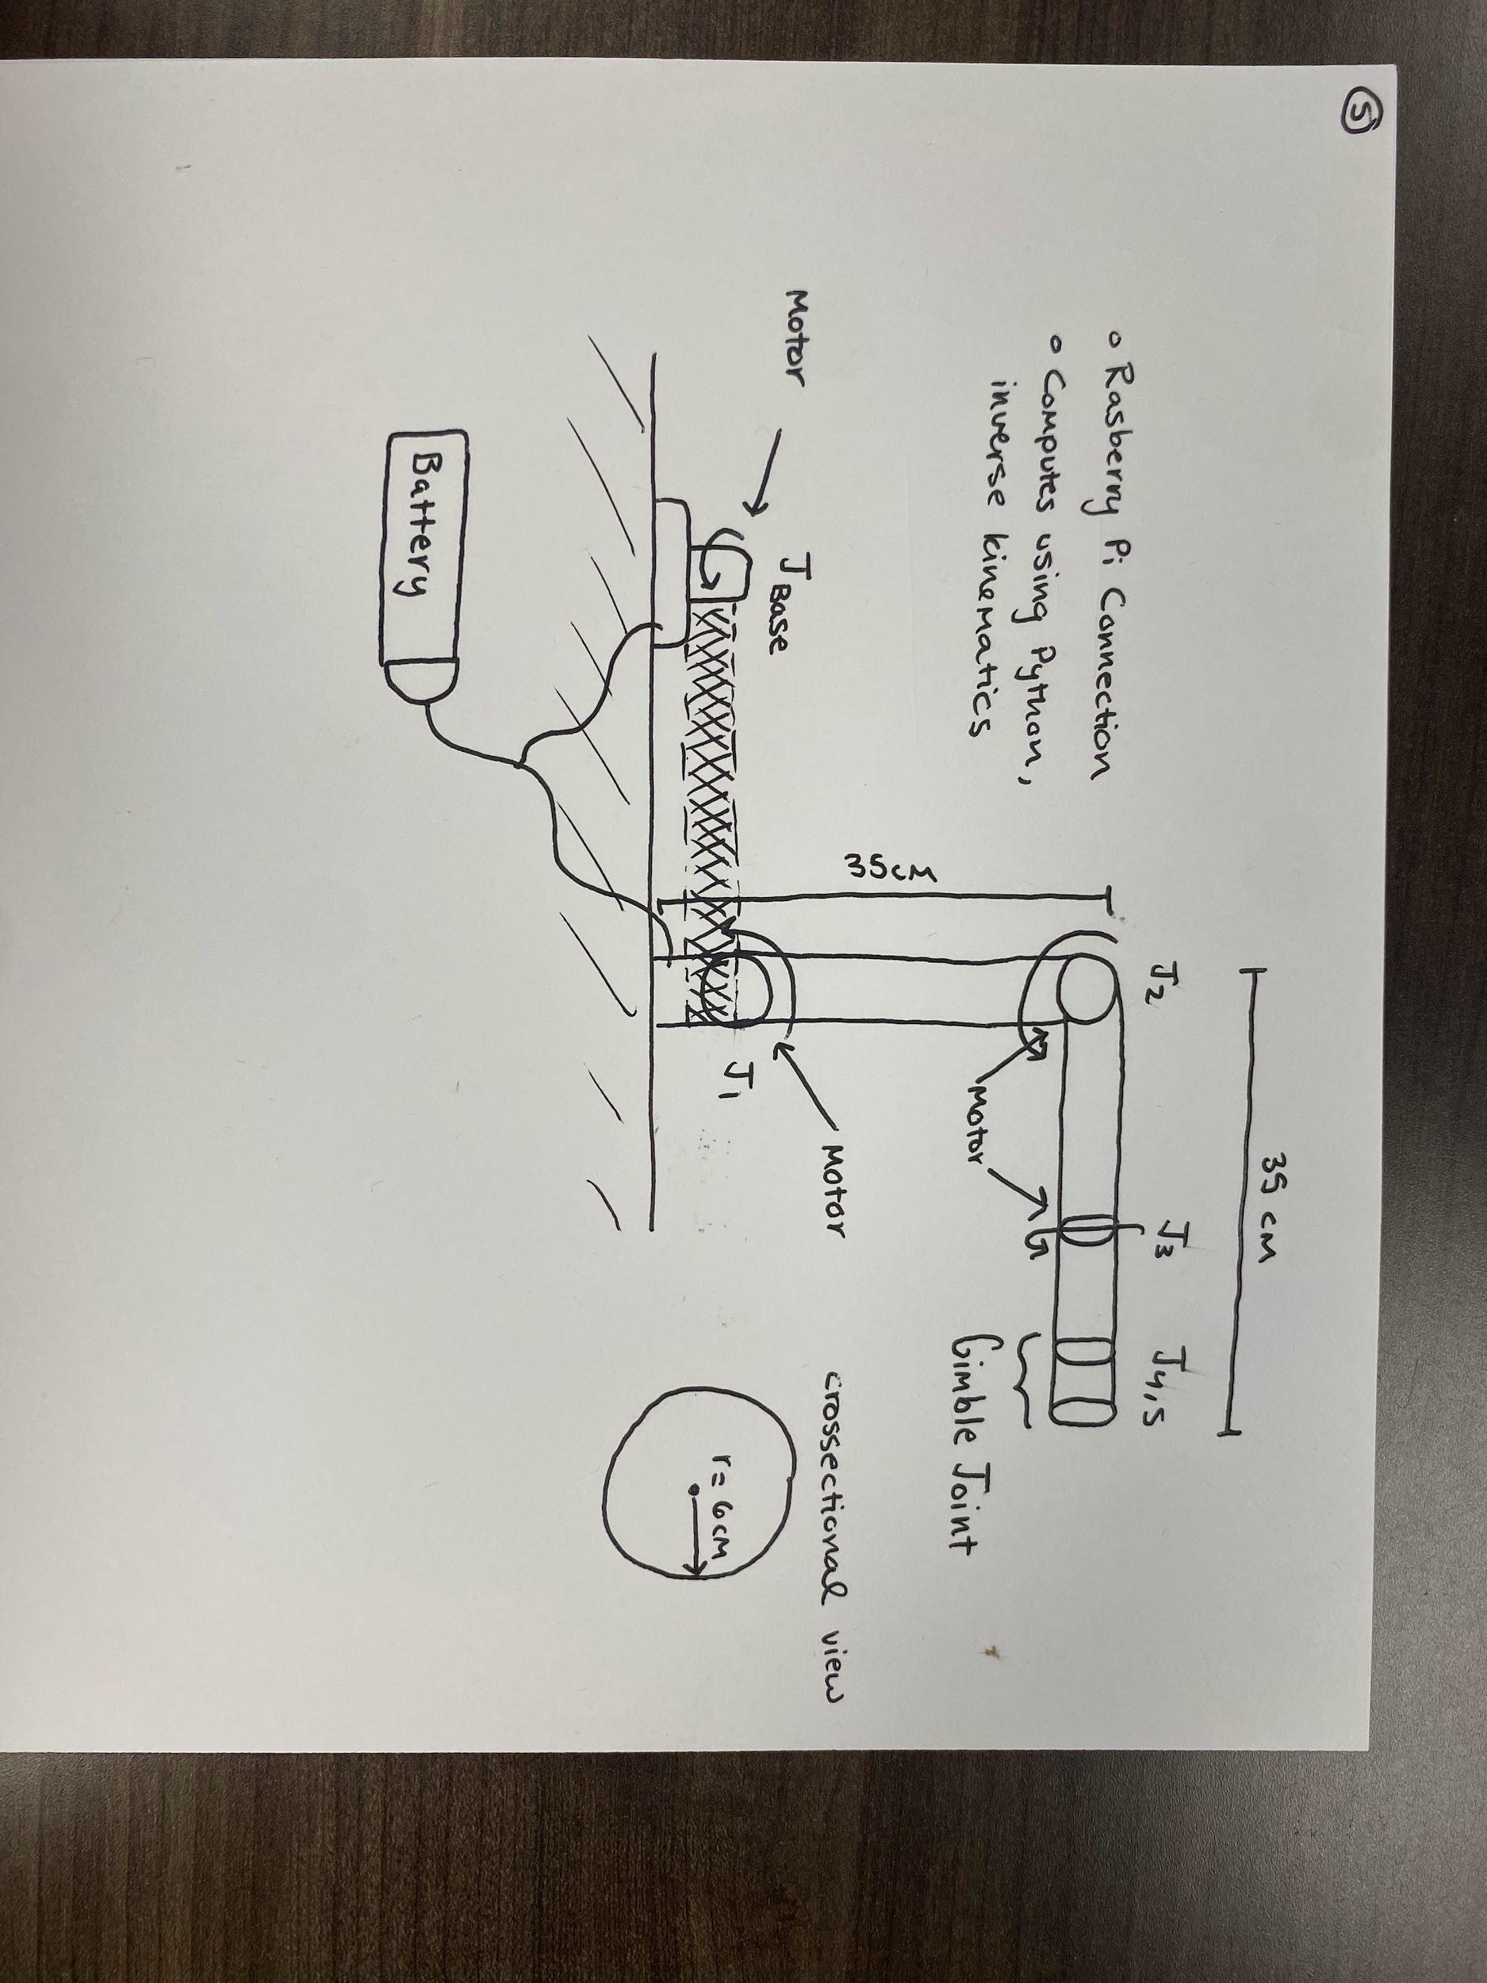
Concept 1

Slide 29
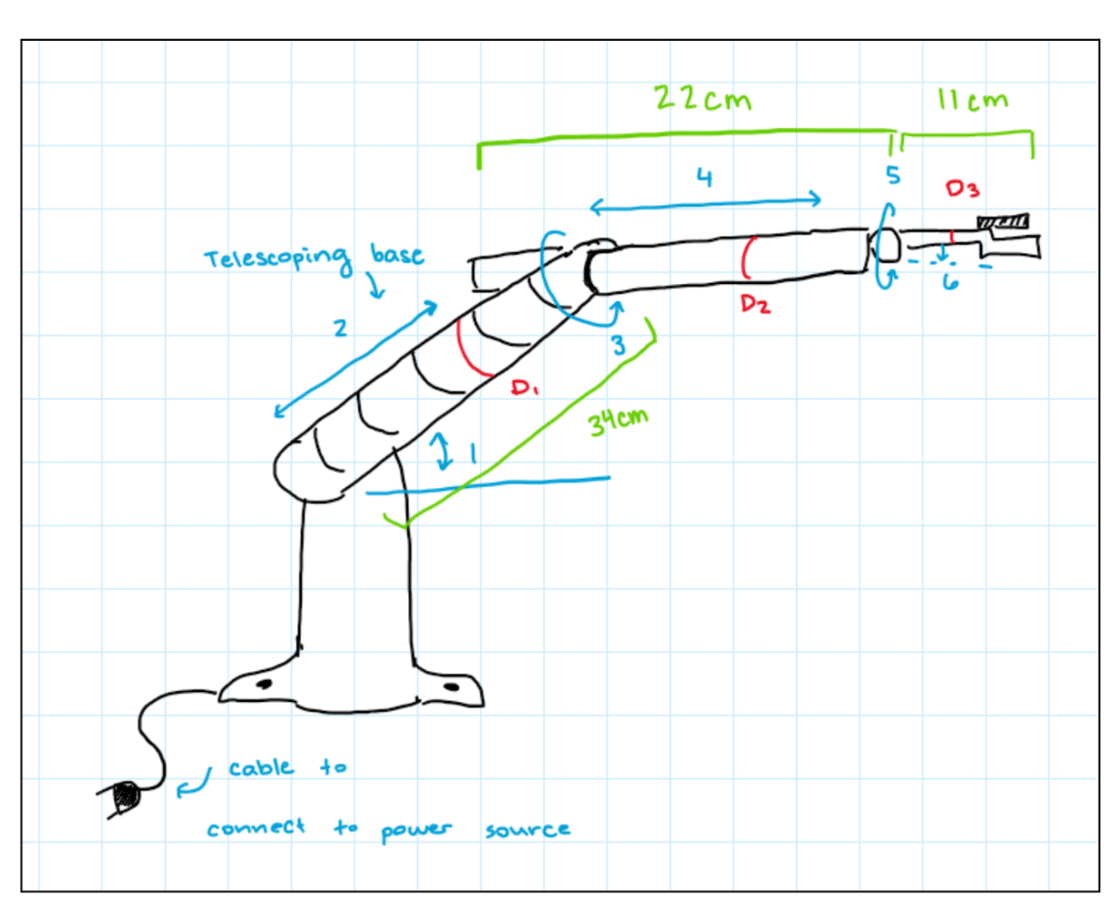
Concept 2

Slide 30
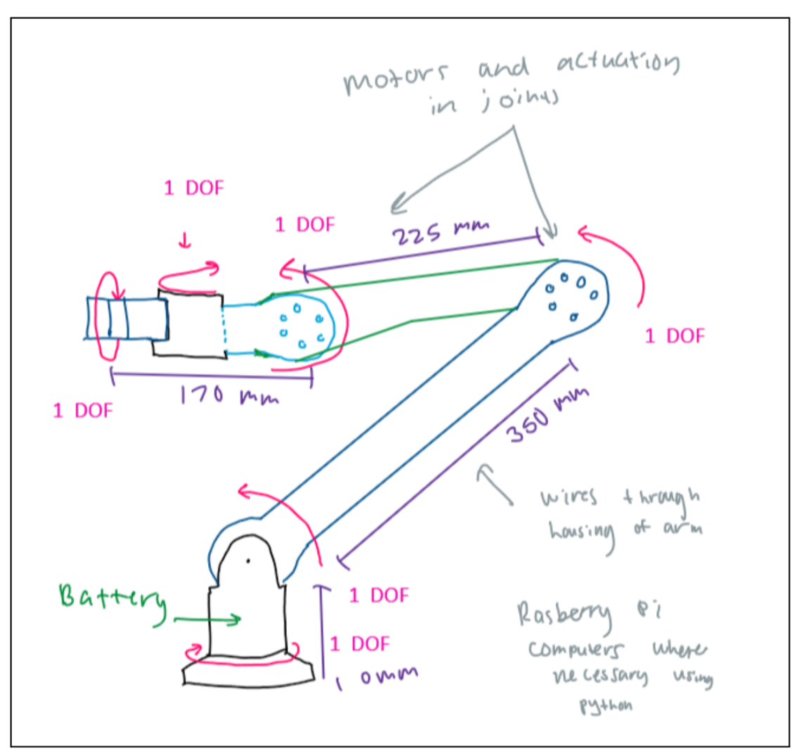
Concept 3

Slide 31
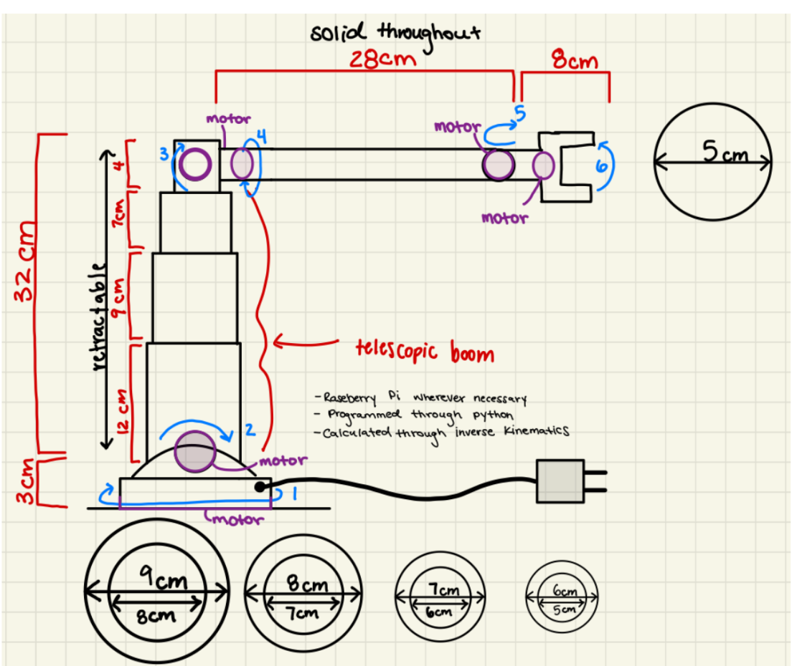
Concept 4

Slide 32
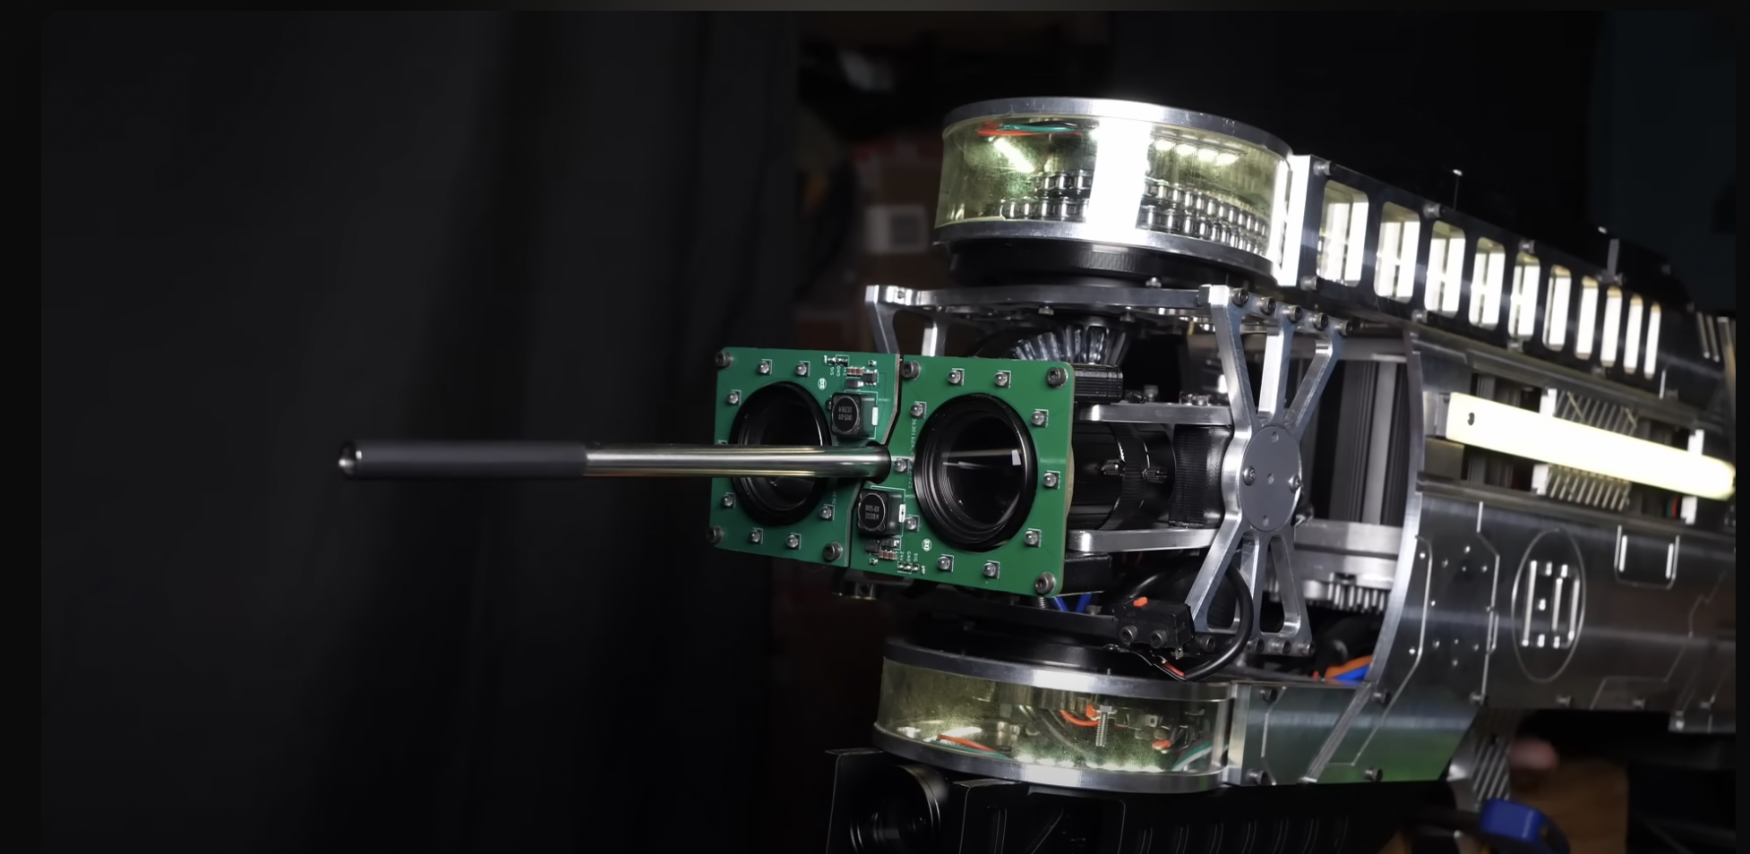
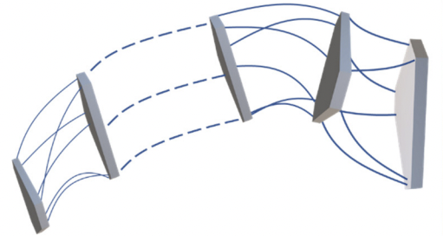
Sponsor Concept

Slide 33
Concept Selection
Pugh Chart
Quantitatively Driven Team Effort Selection Matrix
Concept Selection CAD Model

Slide 34
Concept Selection
Pugh Chart
A decision-making tool used to compare design alternatives.
Helps visualize how well each concept meets customer needs against a datum.
Supports systematic evaluation and selection of the best design option.
Datum Design (Concept 3): Baseline with all scores set to zero.
Concept 4: Highest score of 0.2867 (most stable and lightweight).
Concept 1: Score of -0.6817 (underperformed).
Concept 2: Score of -1.1326 (underperformed).
Conclusion: Concept 4 is the best design option due to its balance of lightweight, speed, and stability.
Selection Criteria | Weight | Concept 1 | Concept 2 | Concept 3 (Datum) | Concept 4
Highly Maneuverable / Fast | 0.1154 | 0 | 2 | 0 | 1
Precise/Accurate Control | 0.0762 | 0 | 0 | 0 | 0
Versatile | 0.1923 | -1 | -2 | 0 | -1
Durable under harsh conditions | 0.1538 | -1 | -1 | 0 | -1
Stable | 0.1818 | -1 | -2 | 0 | 2
Lightweight | 0.1538 | -1 | -2 | 0 | 2
Semi-Autonomous | 0.1538 | 0 | -1 | 0 | -1
Sum |  | -0.6817 | -1.1326 | 0 | 0.2867
Notes:
Evaluation Process:
Determine Selection Criteria and weight: Based on Customer Needs and weight pulled from HOQ ranking .
Identify Alternatives: Four individual concepts evaluated.
Rate and Rank Alternatives: Score each concept from -2 to +2. ( weighting based on concept values and comparison)
Evaluate Results: Multiply scores by weights; sum to get total scores.
Understand Limitations: Acknowledge subjectivity in ratings.

Slide 35
Concept Selection
The Quantitatively Driven Team Effort Selection Matrix (QDTESM) allows the team to evaluate concepts using quantifiable, performance-based criteria through calculated engineering values, providing a more objective comparison than qualitative methods
Each concept generated values based on their design for each Function Requirement
Functional Requirements | Concept 1 | Concept 2 | Concept 3 | Concept 4
Weight of Arm (kg) | 10.67 | 13.24 | 9.08 | 5.723
Maximum Torque Output (Nm) | 5.83 | 2.8 | 5.21 | 3.9
Positional Accuracy (mm) | 10-30 | 10-30 | 10-30 | 10-30
Reach of Robotic Arm (m) | 0.7 | 0.67 | 0.74 | 0.71
Frequency of Motion (Hz) | 1 | 25 | 1 | 1.67

Slide 36
Concept Selection
Selection Criteria | Criteria Importance | Concept 1 |  | Concept 2 |  | Concept 3 |  | Concept 4
 |  | Raw | Weighted | Raw | Weighted | Raw | Weighted | Raw | Weighted
Weight of Arm (kg) | 0.3 | 0.658 | 0.197 | 0.0 | 0.0 | 0.447 | 0.134 | 1.0 | 0.3
Maximum Torque Output (Nm) | 0.1 | 1.0 | 0.1 | 0.0 | 0.0 | 0.795 | 0.080 | 0.363 | 0.036
Positional Accuracy (mm) | 0.05 | 0.0 | 0.0 | 0.0 | 0.0 | 0.0 | 0.0 | 0.0 | 0.0
Reach of Robotic Arm (m) | 0.15 | 0.429 | 0.064 | 0.0 | 0.0 | 1.000 | 0.150 | 0.571 | 0.086
Frequency of Motion (Hz) | 0.4 | 0.0 | 0.0 | 1.0 | 0.4 | 0.0 | 0.0 | 0.028 | 0.011
Total | 1 | 0.362 |  | 0.400 |  | 0.364 |  | 0.433
Parameters with different units were scaled by setting the worst value to 0 and the best to +1.
Intermediate concept values were linearly interpolated between 0 and 1.
Scaled values were then multiplied by each criterion's weight.
Weighted scores were summed to determine each concept’s overall rating.

Slide 37
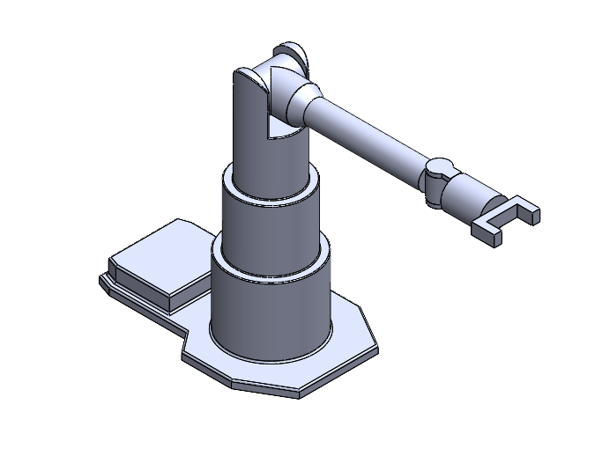
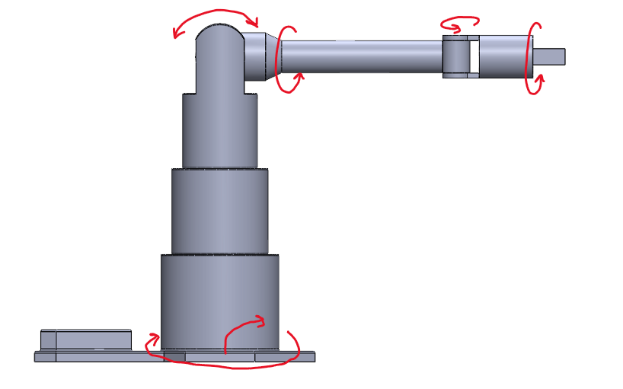
Concept Selection

Slide 38
Embodiment Design
Product Architecture
Definitive Layout
Technical Analysis
Preliminary Product Risk Analysis

Slide 39
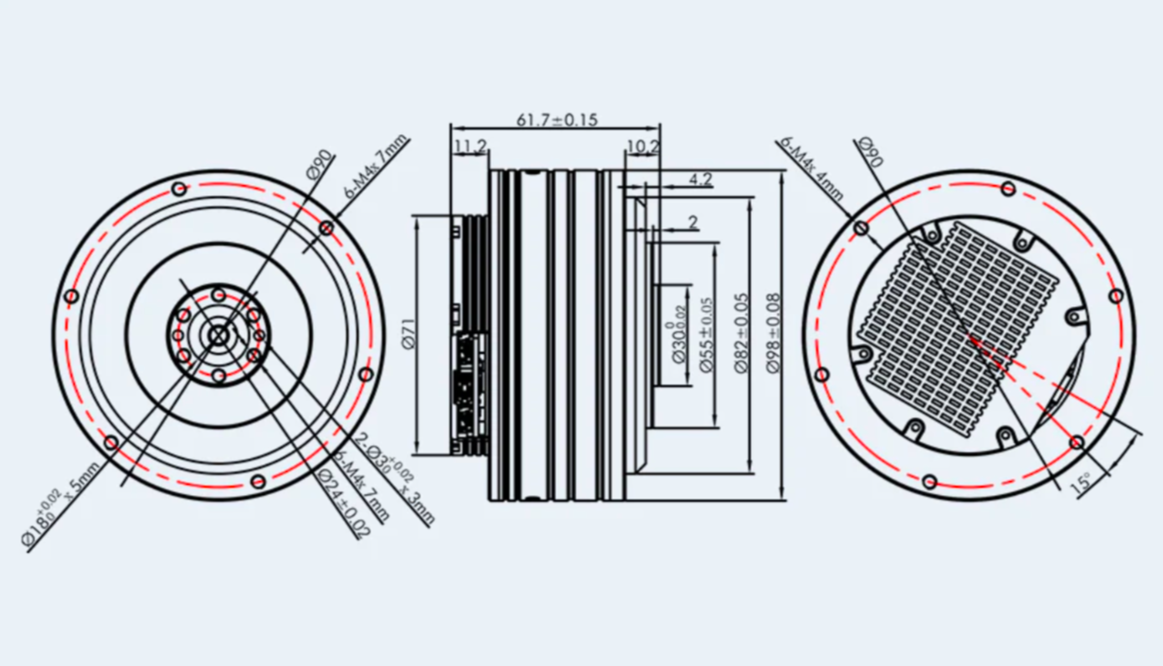
Fasteners
Motor Connections
All range from M4, M6, and M2 connections for motor connections
Plan to utilize these screws in PLA connections and metal Extrusion Connections to reduce cost and complexity
Notes:
Dalton:
Why we need Heat Set Inserts
Need to be Soldered
Why the screws need to be specific lengths
WHy we need M6 and M4 (compatibility with Different motors and Base)
Fastener analysis huge factor of our design
Talk about Tslot nuts
Why we had to increase to 40x40 Extrusions
You can help explain in the drawings with morgan and Izzy how we plan on securing certain fasteners to motors/3D printed parts

Slide 40
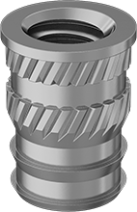
Fasteners
Heat Set Inserts for 3D Printing
What: Threaded metal inserts (usually brass) installed into plastic parts
How: Heated and pressed into pre-designed holes, melting surrounding plastic
Why: Provide stronger threads than tapped or printed plastic threads
Benefits:
Improved pull-out and torque resistance
More wear-resistant than plastic threads
Suitable for most thermoplastics (PLA, ABS, PETG, etc.)
Installation:
Use soldering iron (set ~10-20°C above printing temperature)
Press insert into slightly undersized hole
Allow plastic to cool and solidify around insert
Notes:
Dalton:
Why we need Heat Set Inserts
Need to be Soldered
Why the screws need to be specific lengths
WHy we need M6 and M4 (compatibility with Different motors and Base)
Fastener analysis huge factor of our design
Talk about Tslot nuts
Why we had to increase to 40x40 Extrusions
You can help explain in the drawings with morgan and Izzy how we plan on securing certain fasteners to motors/3D printed parts

Slide 41
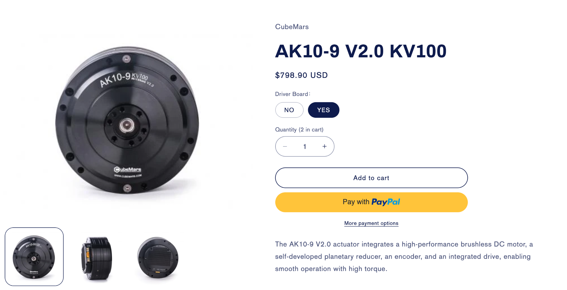
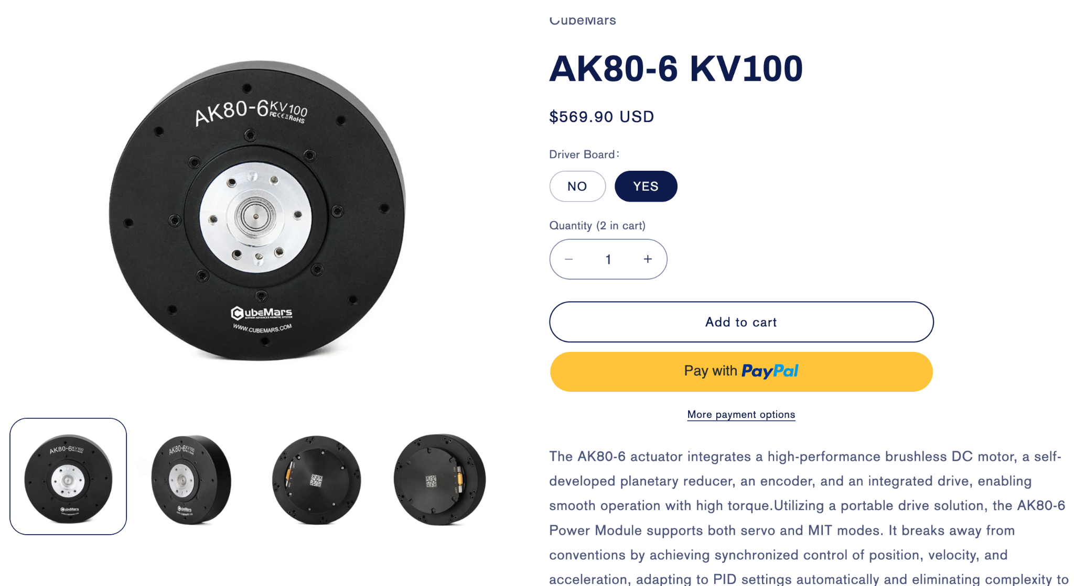
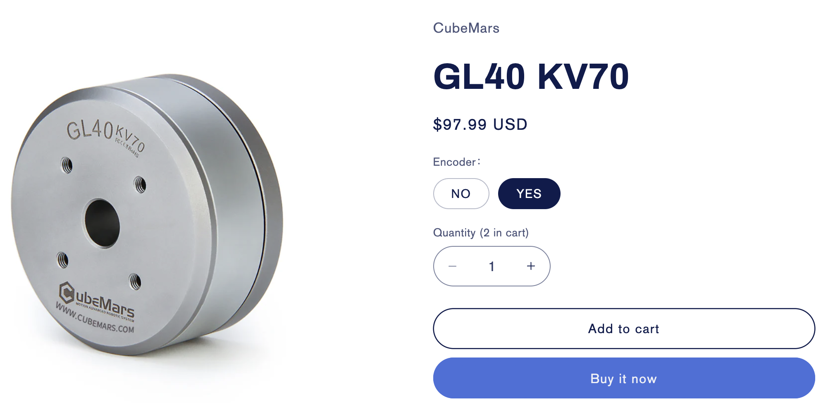
Motor Selection
Shoulder Joint
Elbow Joint
Wrist Joint

Slide 42
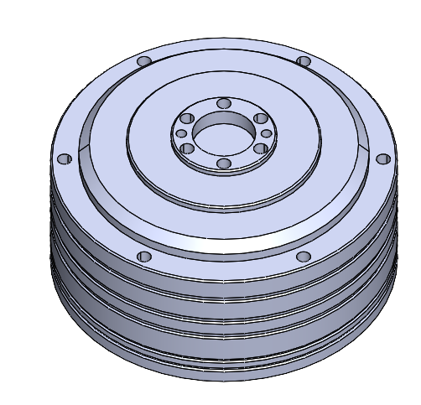
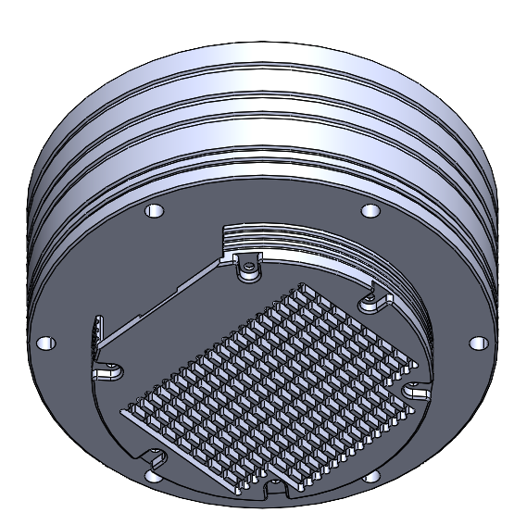
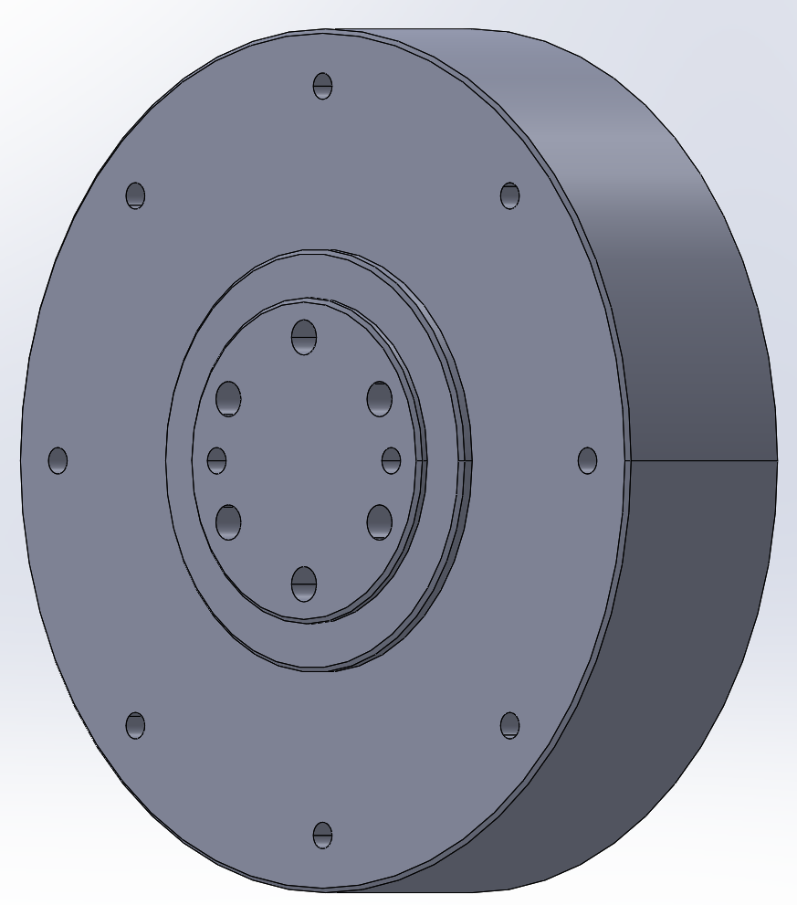
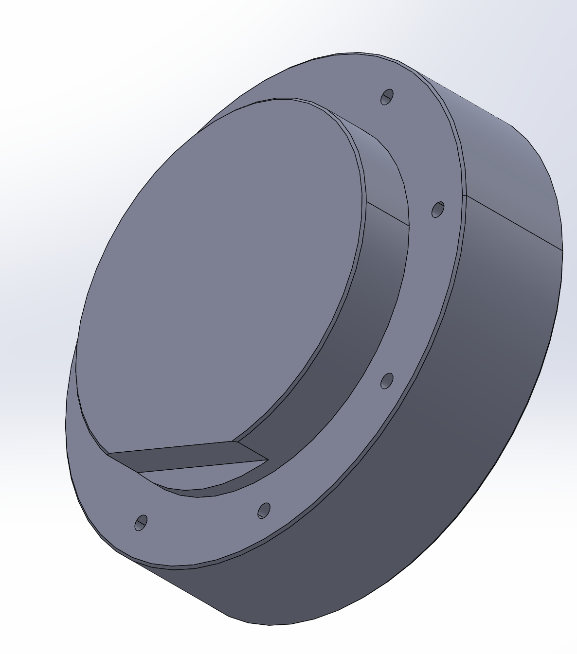
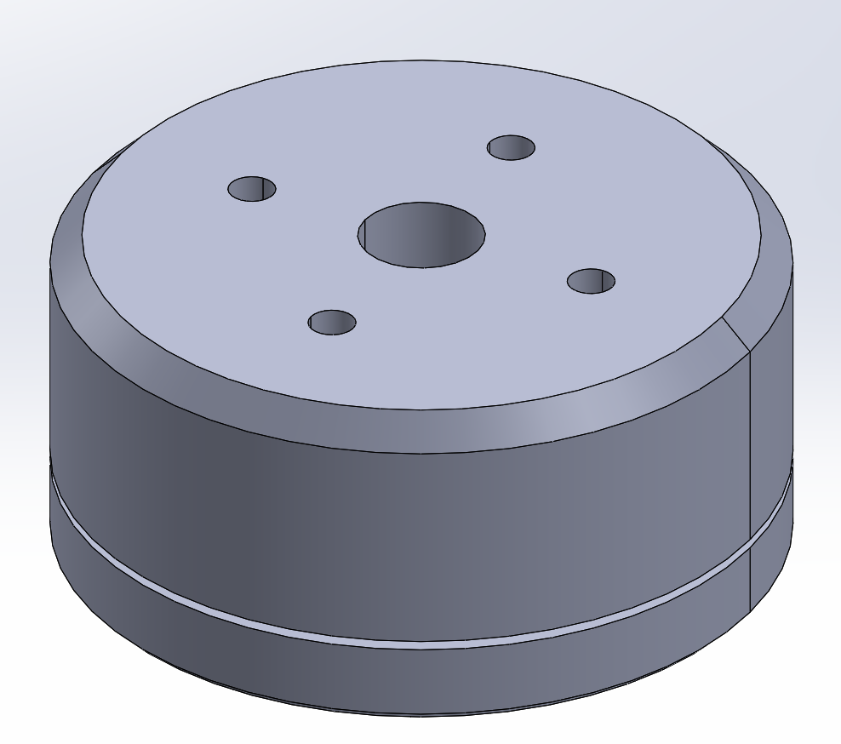
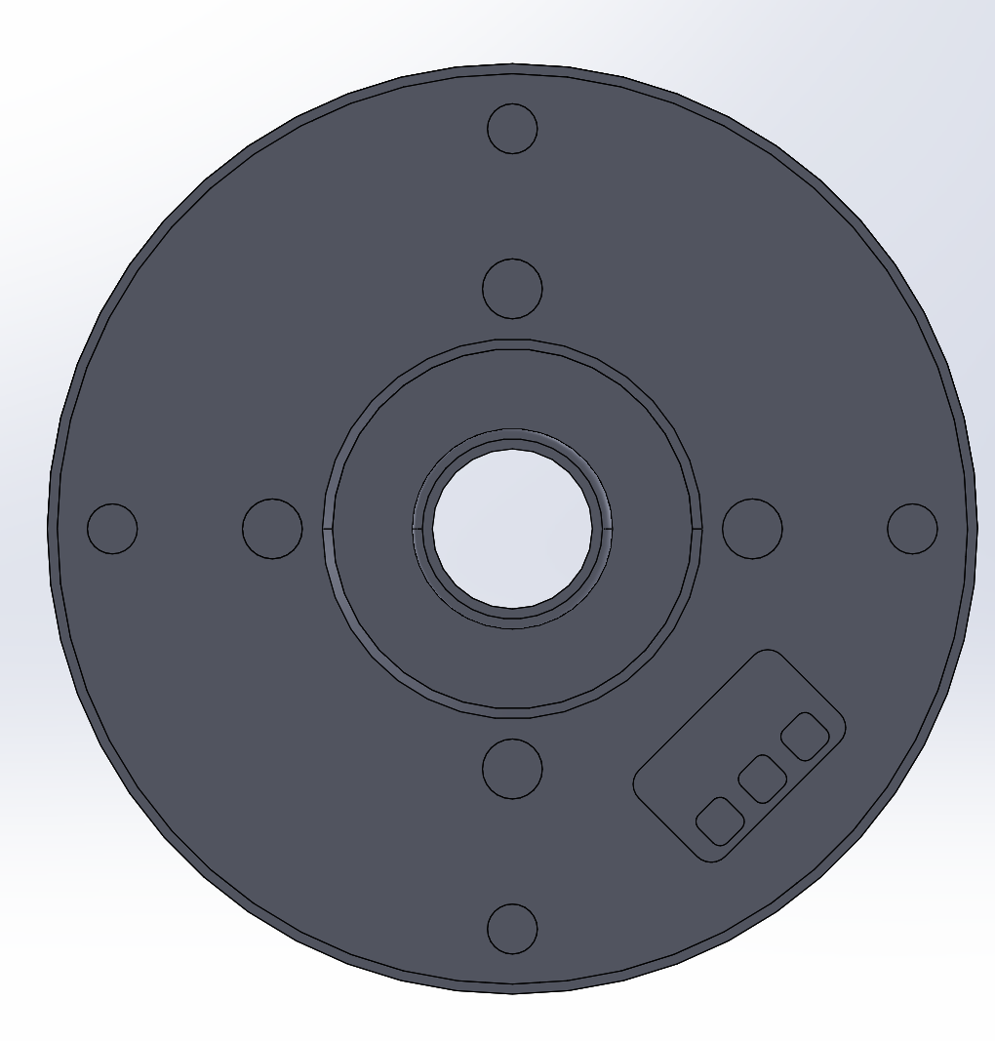
Detailed CAD - Joint Motor(s)
We selected brushless DC motors and prioritized speed
Each motor comes with an encoder and driver
Reached out to CubeMars and asked for detailed CAD models of motors

Slide 43
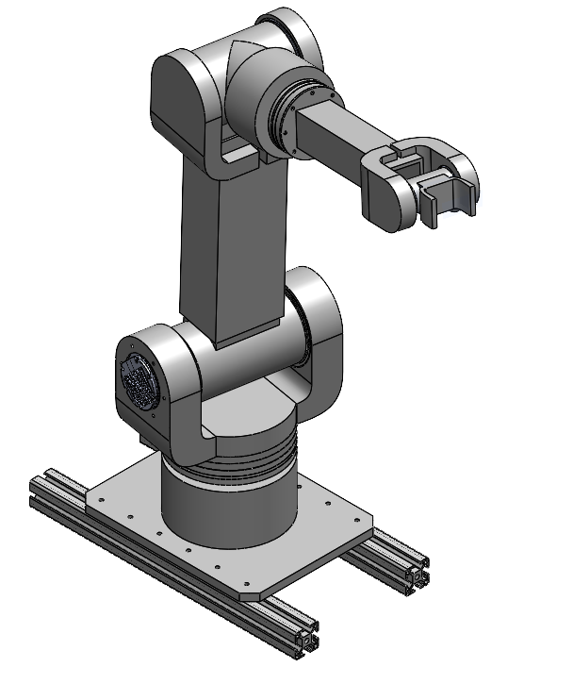
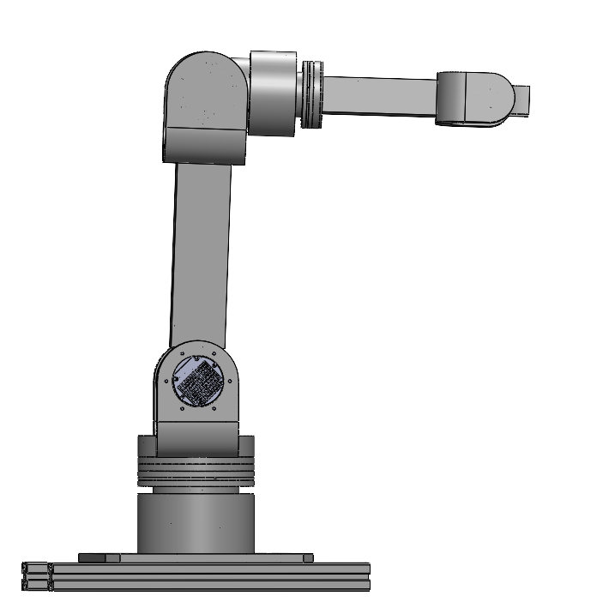
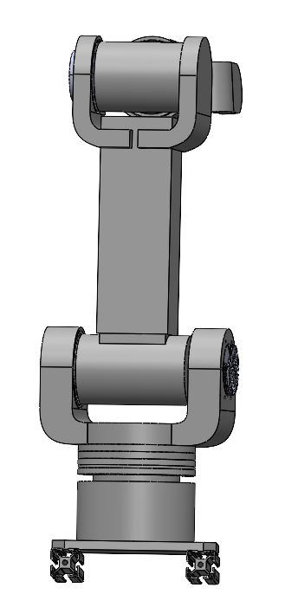
Detailed CAD Assembly

Slide 44
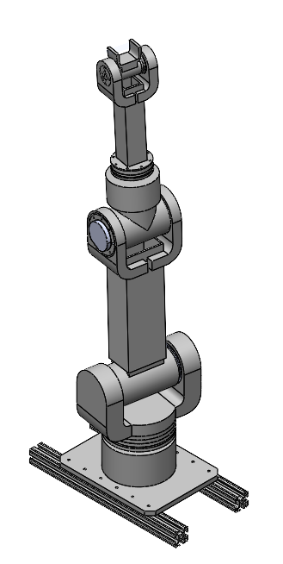
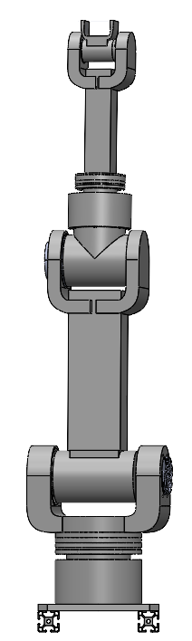
Detailed CAD - Full Upright Extension

Slide 45
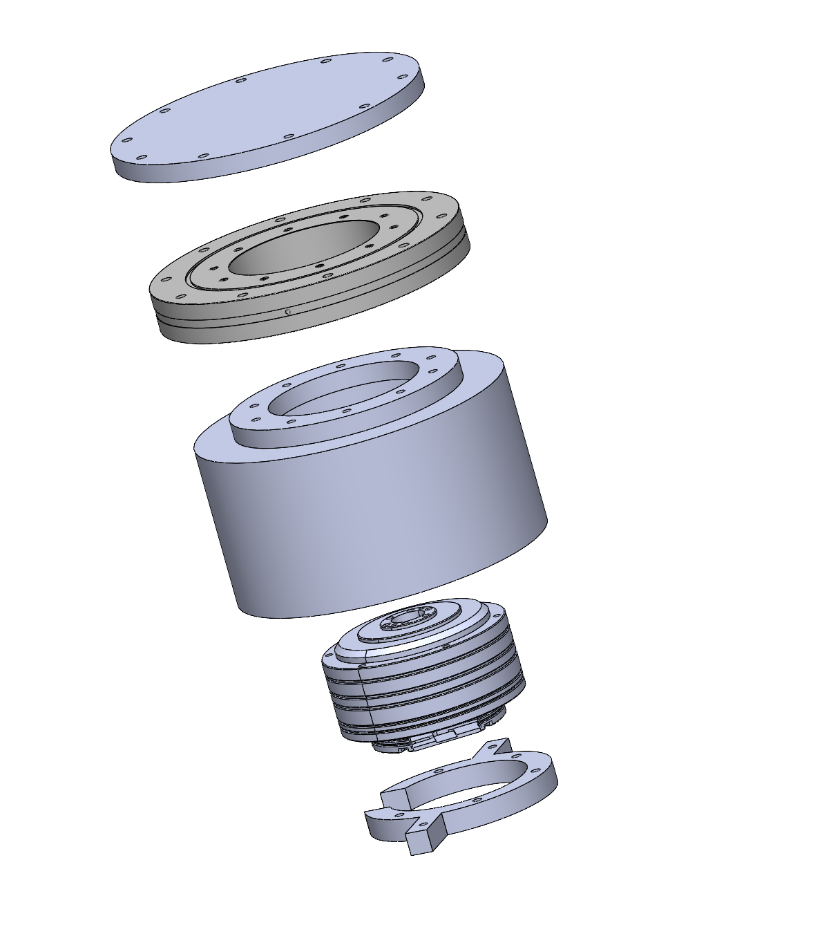
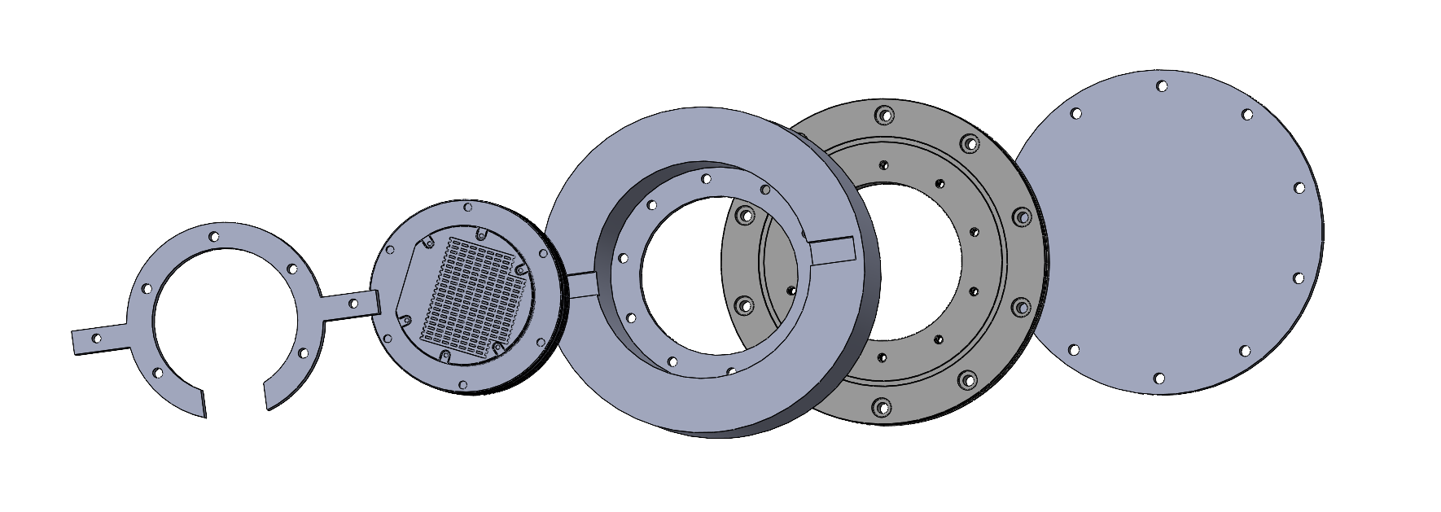
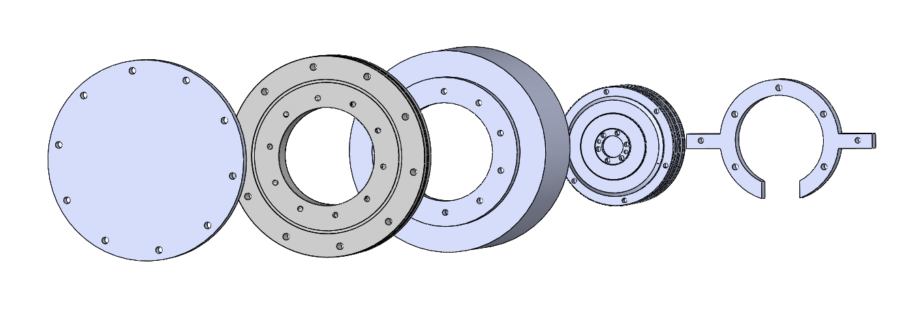
Embodiment Design- J1

Slide 46
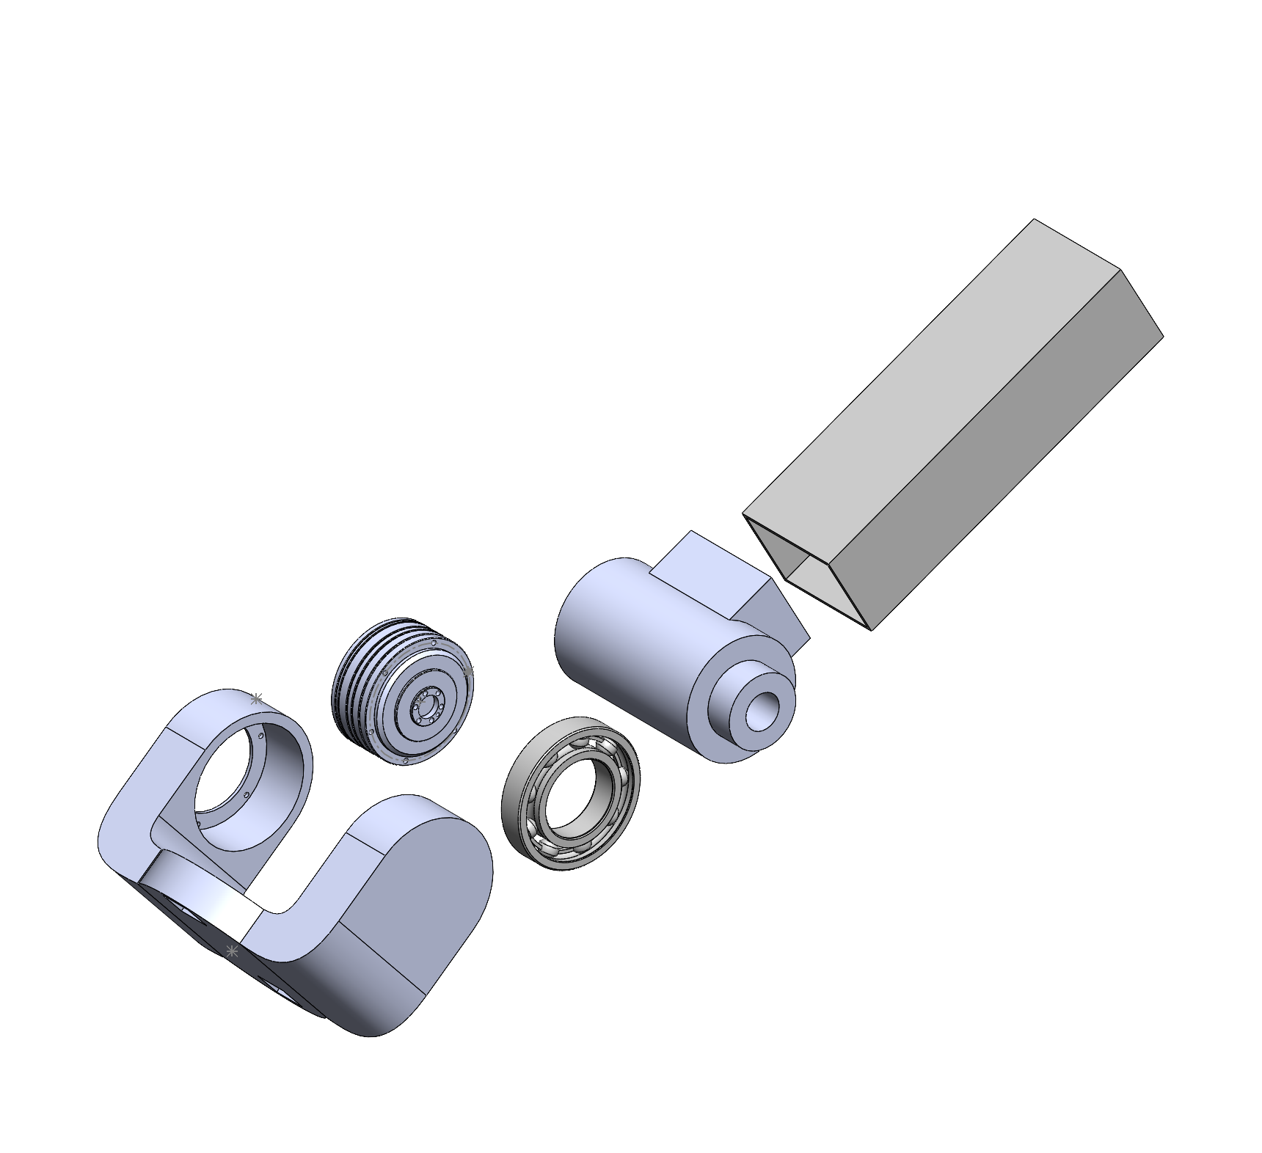
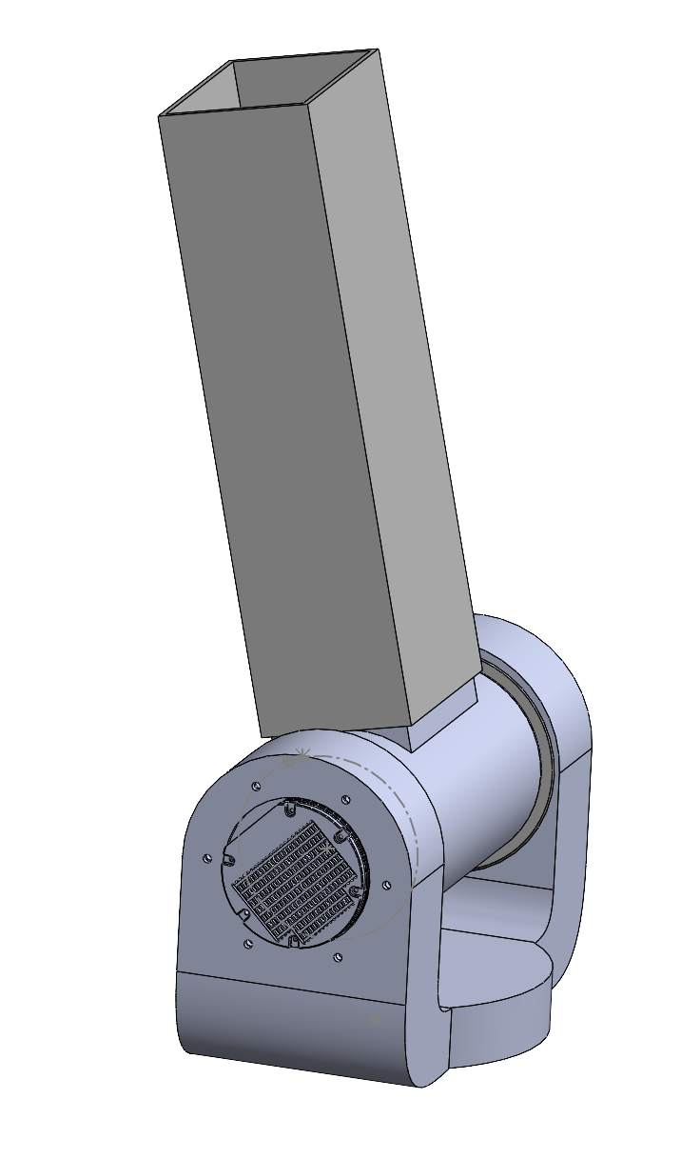
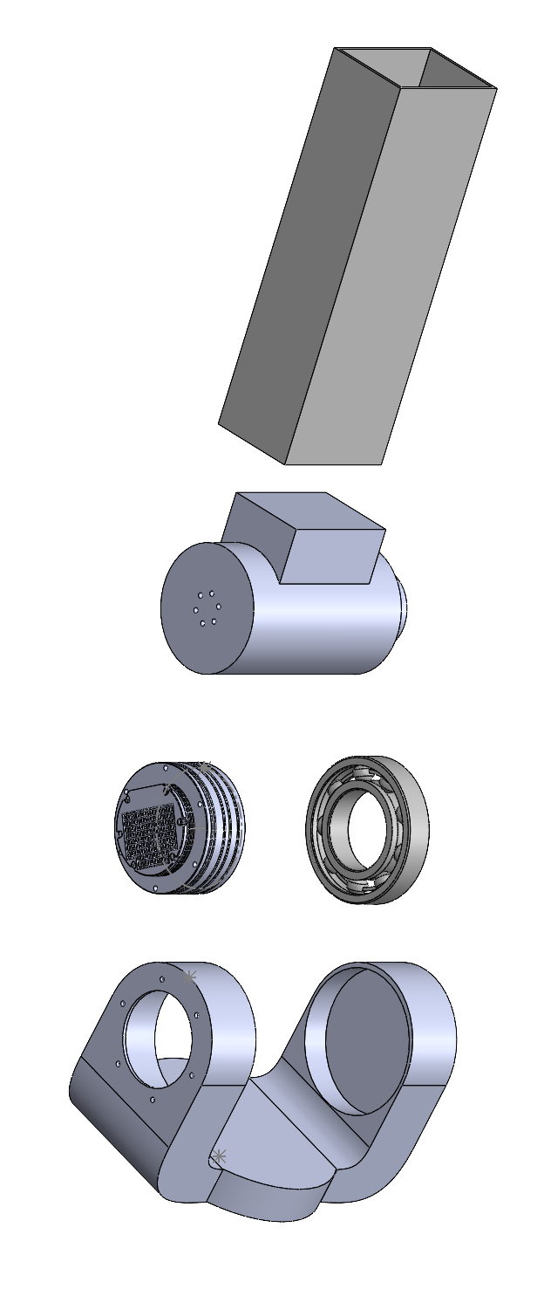
Embodiment Design-J2

Slide 47
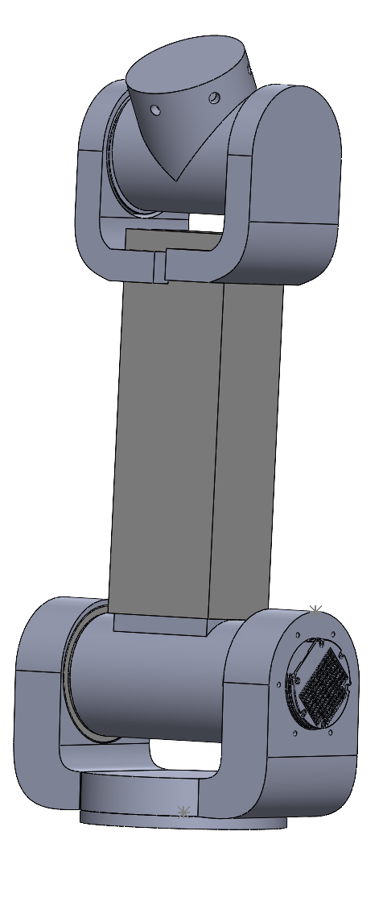
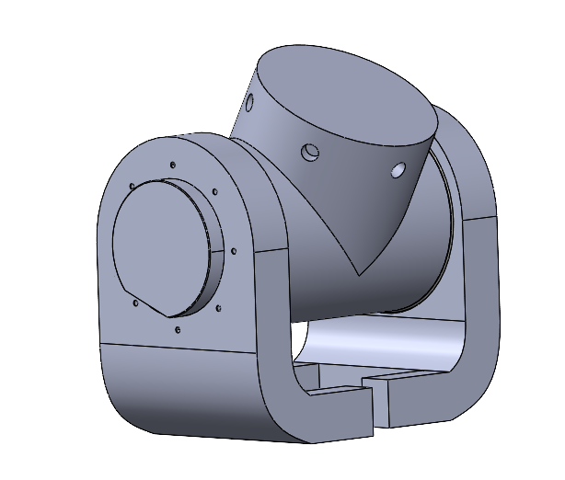
Embodiment Design-J3

Slide 48
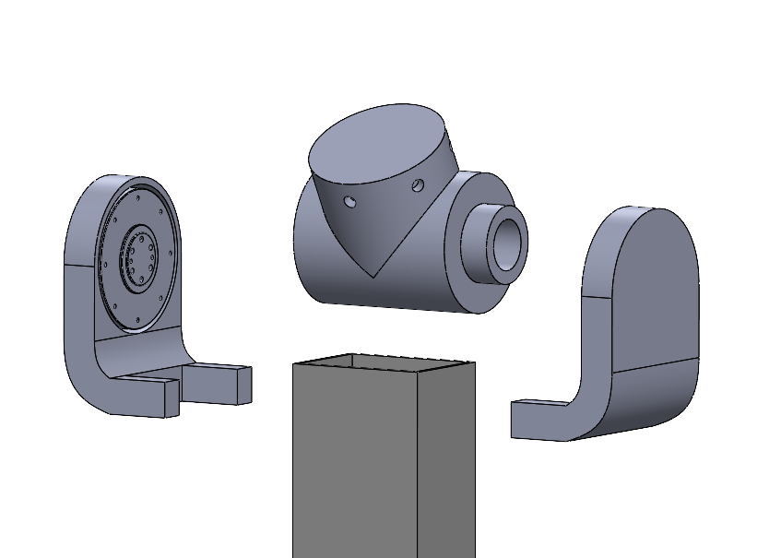
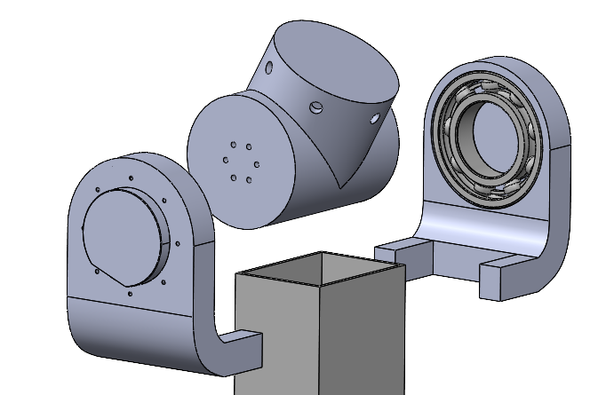
Embodiment Design-J3

Slide 49



Embodiment Design-J4

Slide 50


Embodiment Design-J5

Slide 51
Detailed CAD Assembly

Slide 52





Electrical Components
Power and CAN Connection

Slide 53


Material Testing: 3 Point Test
Performed 3 point bending test in order to calculate the maximum flexural force and force displacement graph
Maximum Flexural Force: 118 N

Slide 54


Material Testing: Tensile Test
Performed tensile test in order to calculate the Tensile Strength, Elastic Modulus, Yield Strength, and Mass Density
Experimental Procedure:
Measured the PLA sample with calipers
Set grips at 25 mm from each end of the sample
Set test speed to 5 mm/min
Measured elongation of sample after plastic deformation was reached

Slide 55


Material Properties from Testing
Elastic Modulus | 1367.00 | MPa
Mass Density | 773.32 | kg/m^3
Tensile Strength | 11426304.65 | N/m^2
Yield Strength | 14.80 | MPa
Notes:
Received data from test computer and evaluated the stress and strain graph
Calculated the Elastic Modulus by fitting a linear line to the beginning of the data

Slide 56

Material Testing: Tensile Test
Experimental Procedure:
Measured the PLA sample with calipers
Set grips at 25 mm from each end of the sample
Set test speed to 5 mm/min
Measured elongation of sample after plastic deformation was reached

Slide 57



Calculations

Slide 58
Material Testing: 3 Point Test
Experimental Procedure:
Measured the PLA sample with calipers
Set support span to 108 mm
Cross head rate 0.005 mm/min

Slide 59

Material Testing: Tensile Test Results
Yield point
Elastic Modulus | 11 | MPa
Mass Density | 773.3248667 | kg/m^3
Tensile Strength | 11426304.65 | N/m^2
Yield Strength | 14.8 | MPa

Slide 60


Validation Through FEA
Utilized SolidWorks for FEA analysis
Used material properties determined from experimentation
Recreated 3 point bending test conditions
Simulated 40% infill

Slide 61


Validation Through FEA
Applied max force of 118N
Yield strength was surpassed at this force indicating plastic deformation
This aligned with experimental results, therefore validating the simulation
Displacement
von Mises
Next Steps
Perform FEA on each joint to ensure a validate design that will not collapse

Slide 62


Payload Verification - J2
Payload Analysis - J2 Max Length
Type | Weight (kg) | Length (mm) from J2 | Overall Torque on J2 (Nm)
A - aluminium extrusion | 0.9 | 239 | 21.3286077
B - PLA | 0.55 | 501.5 | Max Torque (Nm)
C- PLA | 0.738 | 684 | 42
J3 - AK80-6 KV100 | 0.485 | 478 | Mass Density (g/m^3)
J4 - AK80-6 KV100 | 0.485 | 525 | 774
J5 - GL40 KV70 | 0.107 | 807
J6 - GL40 KV210 | 0.107 | 0
B3 | 0.63 | 478
B4 | 0.386 | 561
B5 | 0.109 | 807

Slide 63

Payload Verification - J2
AK10 -9 Motor
Current = 22 Amps
Efficiency = 85%
Speed = 380 RPM
Power = 880 W

Slide 64

Payload Verification - J3
Payload Analysis - J2 Max Length
Type | Weight (kg) | Length (mm) from J2 | Overall Torque on J2 (Nm)
B - PLA | 0.55 | 188 | 3.74079825
C- PLA | 0.738 | 206 | Max Torque (Nm)
J4 - AK80-6 KV100 | 0.485 | 47 | 12
J5 - GL40 KV70 | 0.107 | 329 | Mass Density (g/m^3)
J6 - GL40 KV70 | 0.107 | 0 | 774
B4 | 0.386 | 83
B5 | 0.109 | 329

Slide 65

Payload Verification - J3
AK80-6 Motor
Current = 6 Amps
Efficiency = 78%
Speed = 650 RPM
Power = 240 W

Slide 66

Robotics Controls

Slide 67
Validation Plan for MEEN 402
Finite Element Analysis to ensure that the robot will not collapse
Inspect all joints to ensure they are free from any obstructing components
Implement initial codes for small translational/rotational movements to validate the motor inputs correspond with the output performance
Validate each motor one at a time before trying to perform movements with multiple at once

Slide 68
MEEN 401 Scheduling and Managing a Project
Work Breakdown Structure
Task Dependency Diagram
Gantt Chart
Risk Assessment Analysis

Slide 69

MEEN 401 Scheduling and Managing a Project
Work Breakdown Structure
A Work Breakdown Structure (WBS) is defined as a hierarchical decomposition of a project into smaller components; an assembly of tasks that correspond to a particular activity performed on a project
Directly related to the MEEN 401 lecture schedule defined through writing assignments and milestones

Slide 70

MEEN 401 Scheduling and Managing a Project
Task Dependency Diagram
Directed graph indicating the required sequencing among a set of tasks; way to visualize the specific order of tasks that need to be taken to reach the completion of the project
Creating the TDD allows the team to find the critical path, which is defined as the sequence of steps that require the longest time to complete; defined in red

Slide 71

MEEN 402 Scheduling and Managing a Project
Gantt Chart
A Gantt chart is a graphical representation that includes task sequencing, task dependencies, milestones, resource usage, critical path, and personal responsibility
Organizes the tasks for the semester of of MEEN 402

Slide 72

Holiday Break Scheduling

Slide 73
Preliminary Product Risk Analysis
Part and Function | Potential Failure Mode | Potential Effects of Failure | Severity | Potential Causes and Mechanism of Failure | Occurrence | Current Design Control Test | Detection | Recommended Action | RPN
Actuators (Joint Motors) | Failure to move or incorrect movement | Inability to position the arm correctly, leading to task failure or collision | 9 | Motor wear, overload, overheating, power supply issue, seizing | 4 | Periodic motor inspection | 3 | Upgrade motor rating, add overload protection | 108
Control System (Software) | Failure in control algorithm | Inaccurate control, potential for oscillations, lack of stability | 8 | Software bug, incorrect control tuning, signal noise | 2 | Code reviews, simulation testing | 3 | Improve controller tuning, add redundancy checks | 48
Arm Structure (Links) | Structural failure or deformation | Misalignment in movements, excessive vibration | 10 | Material fatigue, impact load, stress concentration | 2 | Stress analysis during design, load testing | 2 | Use stronger materials, inspect regularly | 40
Encoders (Position Feedback) | Loss of position feedback | Loss of position control, leading to inaccurate movements and potential collisions | 8 | Sensor failure, electrical noise, misalignment | 3 | Regular calibration, signal filtering | 3 | Use higher-quality encoders, improve shielding | 72
Joint Motors | Overuse/Burnout | Motor overheating, reduced lifespan, loss of functionality | 8 | Continuous use, Continuous high load operation, Lack of Cooling | 6 | Thermal sensor monitoring, maintenance checks | 3 | Implement time usage limits and torque limits. | 144
Electrical Failure | Failure to power motors | Loss of movement in the arm, burning out motor | 9 | improper wiring, wrong power source, over use of motors | 3 | checking each individual motor, voltage testing across wires | 3 | Implement wire testing, implement safety on voltage | 81
Structural Components | Fastener Loosening/Thread Stripping | Components loosening/falling out of place/robot becoming unstabilized | 8 | Excessive vibration/parts not moving cohesively together/moving against each other | 5 | Testing each motor individually/confirming all connectors are secure with proper inserts | 2 | Ensure that each insert is of proper size and screws are rated for high vibrations | 80

Slide 74

MEEN 402 Scheduling and Managing a Project
Risk Assessment Analysis
This helps the team identify potential risks, enabling them to stay on schedule by preparing for negative impacts on the project timeline
Highest Risk Identified: Motor Torque Overloading
Risk Ranking: Probability rated at 4 (High Risk), with a consequence rating of 5 (Extreme)
Primary Concern: Results in motors seizing which could cause the motors to break
Mitigation Strategy: Provide hand calculations with the torque output for each motor; Perform modular motor testing

Slide 75
Final Deliverables
MEEN 401
Produce a detailed CAD model of the robotic arm
Clear visual representation of the anticipated final product and enable the team to plan various validation techniques to ensure the design's success
Develop a validation plan to test the mechanical capabilities of the prototype to be built during MEEN 402
Preliminary budget
Bill of materials
MEEN 402
Create a functional prototype that demonstrates the key features
Undergo optimization tests, including mechanical testing and efficiency analysis
Documented in a report, allowing the team to present the results to the sponsor or future project teams

Slide 76
Future Work
Order all materials and parts for prototyping
Research and evaluate circuit designs/electronics/power supply
Learn and experiment with motor functionality
Write test python scripts for motor maneuverability
Adding Fasteners to the CAD Design
Conducting FEA on Critical Components of Robot

Slide 77

Thank You!

